Slide 1



SPORT &
FOOTBALL
EDUCATION
PROGRAMME
FOR MALES & FEMALES AGED 16-18

Slide 2

WHERE THE COURSE IS THE FOCUS…
THE CAREER IS THE GOAL.

Slide 3

WHO ARE ACCESS SPORT?
Originally established in 2006 (as Coaching Connexions), Access Sport was created in 2019 following a merger with the biggest private training provider in the country, Access Creative College.
As a leading national sports training provider that delivers further and higher education programmes, our objective is to provide tangible exit routes for learners desiring a future career in sport across a variety of pathways.
These include progression onto University, U.S Scholarships, Apprenticeships and future careers within the exciting sport industry.
All while receiving expert coaching and training, developing to their highest ability as a players or athletes across their chosen sport provision.
Bullet list 1
Bullet List 2

Slide 4
















NATIONAL SPORTS
EDUCATION PROVIDER
Liverpool (x4) | Manchester (x3) | Penrith | Derby | Norwich Newcastle | Birmingham | Telford | Lowestoft | Leeds | Chorley Chester | Halifax

Slide 5



WHY CHOOSE
ACCESS SPORT?
Over 92% of learners move onto a positive destination
(University | U.S Scholarship | Employment)
Over 52% of students over achieve their targeted grades
Part of the biggest private 16-18 training provider in the country
Established College (30 years)
Graded “Good” by OFSTED

Slide 6

WHY CHOOSE
ACCESS SPORT?
Range of course and pathways
Delivered by highly qualified tutors
and UEFA certified coaches
100% Assessment, no Exams
Maths & English Progression
(Including GCSE re-sits if required)
Personal & Professional Development
Industry Work Placements
Full pathway support and progression
Build an enriched CV of skills and experiences to boost employability

Slide 7

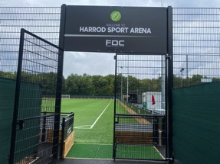
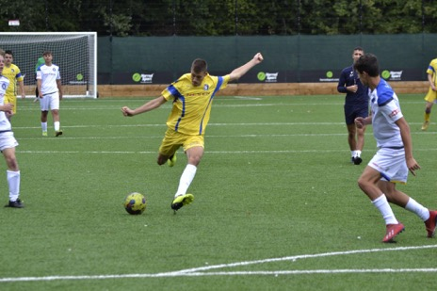
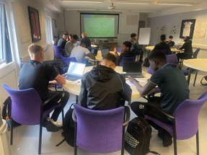
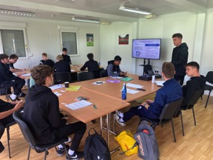
THE FDC NORWICH
£1.75M Redeveloped FDC Centre
New 4G Pitch, Two Classrooms

Slide 8
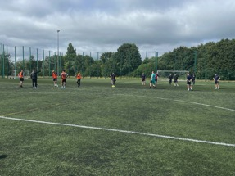
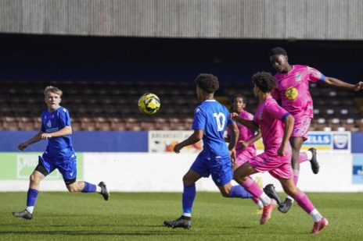
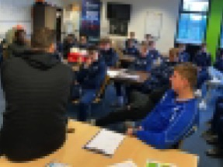
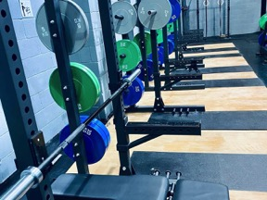
LOWESTOFT
Lowestoft Town Stadium & Barnards
Soccer Centre & The Body Gym
3G Pitch, Stadium Pitch, Classrooms, Gym

Slide 9

THE COURSES &
PATHWAYS
We pride ourselves on providing students with as many opportunities, and progression routes as possible to achieve a future within the sports industry.
Our various courses and pathways provide students with the best blend of theory, practical development, skills, industry qualifications and work experience to match their career ambitions.
Sports Coaching or Sports Science
L3 Extended Diploma Sports Coaching & Development
Public Service
L2 Diploma in Physical Preparation & Employability
Sports Media
L3 Extended Diploma Creative Media (select locations)
Esports
L3 Extended Diploma Esports Management (select locations)

Slide 10

COACHING &
SPORTS SCIENCE
L3 Extended Diploma
Sports Coaching & Development
Equivalent of 3 A Levels
Full Time 2 Year Course
Linked to our Coaching or Sports Science Pathways
100% Coursework & Assessments
Progress onto University, U.S Scholarship or Employment
Course Entry: 4GCSE’s at grades 4-9
Ideally including Maths & English

Slide 11

COACHING &
SPORTS SCIENCE
L2 Diploma
Physical Preparation & Employability
Full Time 1 Year Course
Linked to our Public Service Pathway
or Level 3 Sport Progression
100% Coursework & Assessments
GCSE Maths & English Progression
If required
Progress onto employment within the public sector or our L3 Sports Qual
Course Entry: 3 GCSE’s at grades 3-9
Ideally including Maths & English

Slide 12

SPORTS MEDIA
L3 Extended Diploma
Creative Media
Equivalent of 3 A Levels
Full Time 2 Year Course
Linked to our Sports Media Pathway
100% Coursework & Assessments
Progress onto University, U.S Scholarship or Employment
Course Entry: 4GCSE’s at grades 4-9
Ideally including Maths & English

Slide 13

ESPORTS
L3 Extended Diploma
Esports Event Management
Equivalent of 3 A Levels
Full Time 2 Year Course
Linked to our Esports Pathay
100% Coursework & Assessments
Progress onto University, U.S Scholarship or Employment
Course Entry: 4GCSE’s at grades 4-9
Ideally including Maths & English

Slide 14
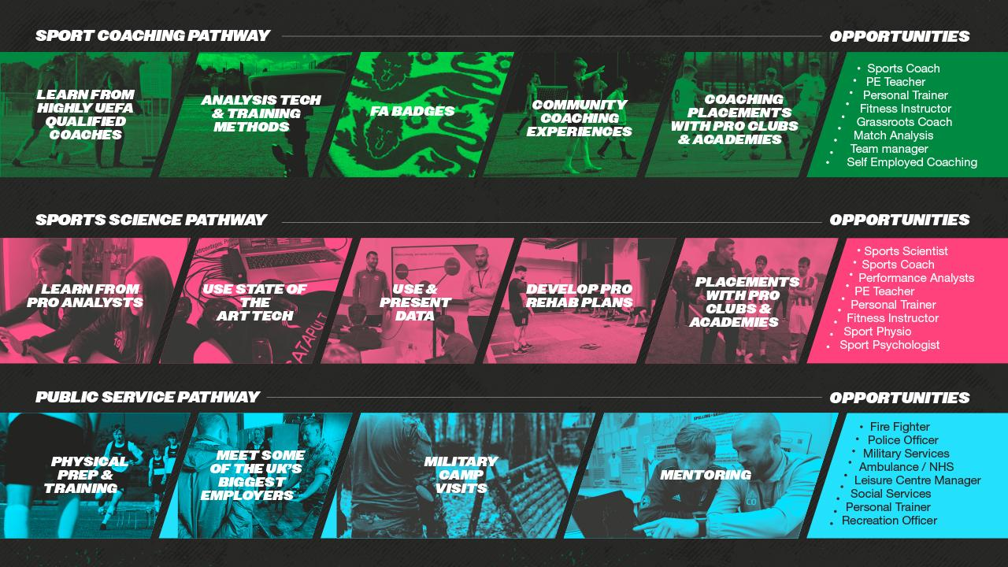

Slide 15


Slide 16


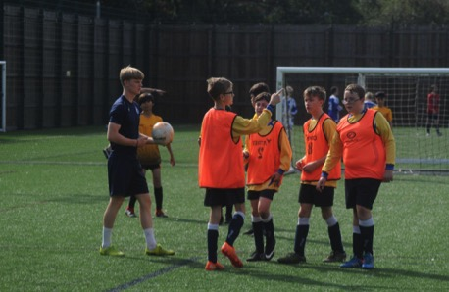
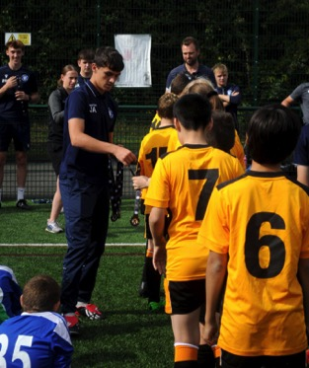
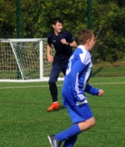
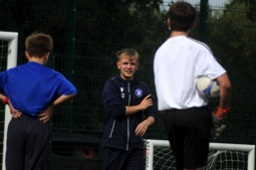
COMMUNITY ENGAGEMENT

Slide 17
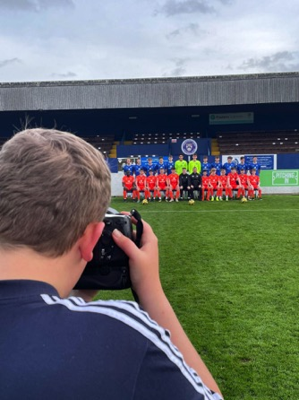
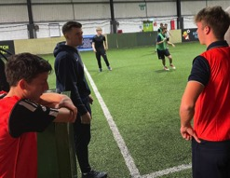
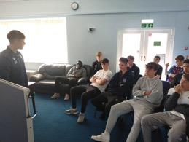
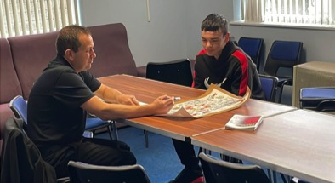
INDUSTRY ENRICHMENT

Slide 18

GO LIVE
PROFESSIONAL & PERSONAL DEVELOPMENT
Weekly Development Sessions
Employability Skills & Experiences
Develop Personal Skills & Knowledge
Career Action Plans with SMART Objectives
Social Responsibility
Culture & Environment

Slide 19

THE PLAYER DEVELOPMENT
Train Four TImes Per Week
Highly Qualified UEFA Coaches
Performance & Development Squads
for all abilities
Competitive Weekly League & Cup Games
Represent partner Lowestoft Town F.C in the FA Youth Cup
Senior First Team Progression and
Pro Club Trial Links
Football Tournament & Tours including MIC Cup (Spain)

Slide 20

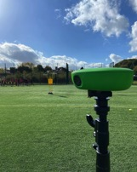
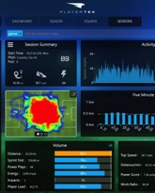
THE PLAYER DEVELOPMENT
Filmed games and training with state of the art VEO 2 Cameras
Catapult GPS Vests to monitor progress and replicate a pro academy
Sports Session Planner for aspiring coaches

Slide 21
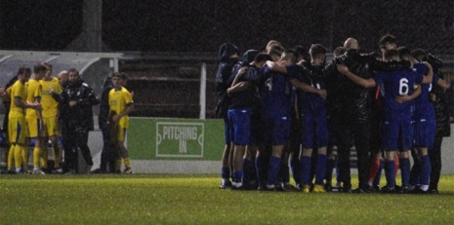
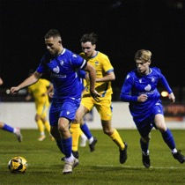





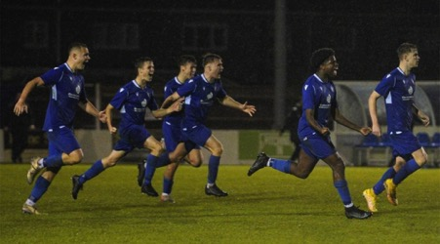
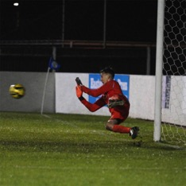

THE FA YOUTH CUP
1-4
0-8
1-2
1-1
pens
?-?

Slide 22

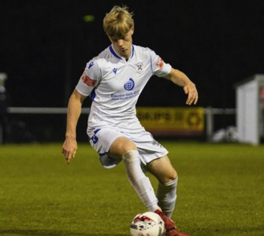
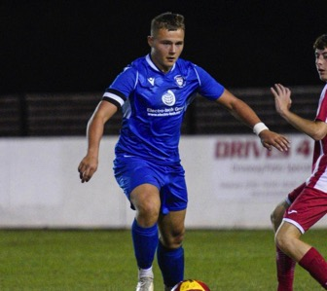
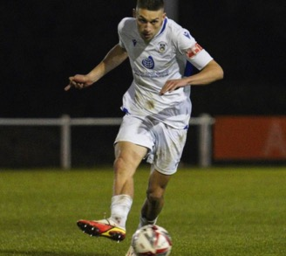

LOWESTOFT TOWN FIRST TEAM SUCCESS
Adam Sherwood
Debut at 16
Josh Harvey
Debut at 16
Professional Club Trials
Owen Lane
Professional Club Trials

Slide 23
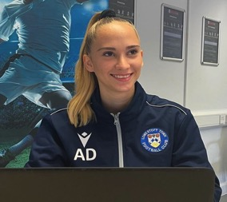
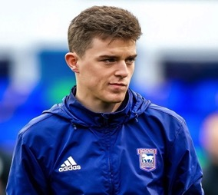
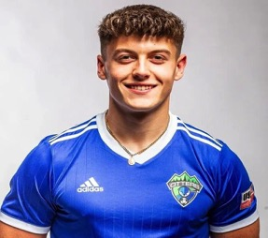
LOCAL ALUMNI SUCCESS
Alexandra Denes
Level 2 Diploma
Level 3 Extended Diploma
Improved GCSE Maths & English
University of Suffolk (Degree)
Cion Wren
Level 3 Extended Diploma
Sports Science Degree
Strength & Conditioning Coach
Tutor at Access Sport
Ant Cox
Level 3 Extended Diploma
U.S Sport Scholarship Bellevue Bruins (Sports Management Degree)
Record for most assist as freshman

Slide 24
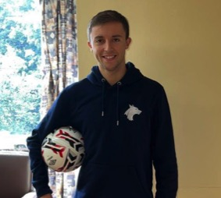
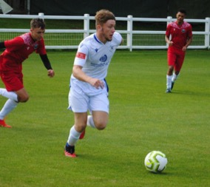
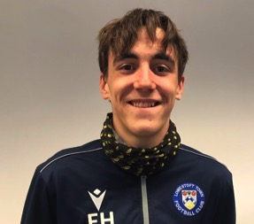
LOCAL ALUMNI SUCCESS
Ben Anderson
Level 2 Diploma
Level 3 Extended Diploma
University Wolverhampton - Sports Coaching Degree
Paid Football Coach while studying
Ollie Limburn
Level 3 Extended Diploma
University Nottingham
P.E Teaching Degree
Ethan Hornigold
Level 3 Extended Diploma
UCFB Wembley Stadium
Sports Media & Broadcasting Degree

Slide 25
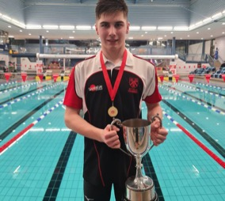
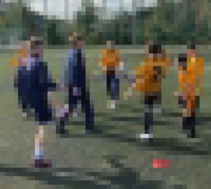
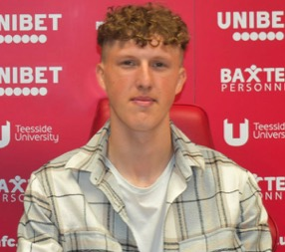
LOCAL ALUMNI SUCCESS
William Ellard
Current Student
Accepted onto the Swim England
Diploma in Sporting Excellence Programme
Conor Gibbs
Level 3 Extended Diploma
University Leeds
P.E Teaching Degree
Josh Wells
Professional Football
Middlesbrough F.C
2 Year Contract

Slide 26
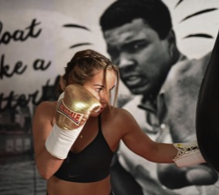
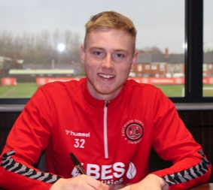
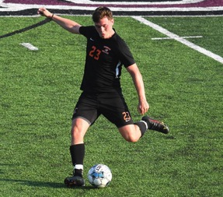
NATIONAL ALUMNI SUCCESS
CHLOE WATSON
Level 3 Extended Diploma
Team GB Boxing
Professional Boxer
PADDY LANE
Level 3 Extended Diploma
Professional Football
Fleetwood Town F.C & Northern Ireland
ALEX JUDD
Level 3 Extended Diploma
U.S Scholarship Governor State Jaguars Chicago

Slide 27
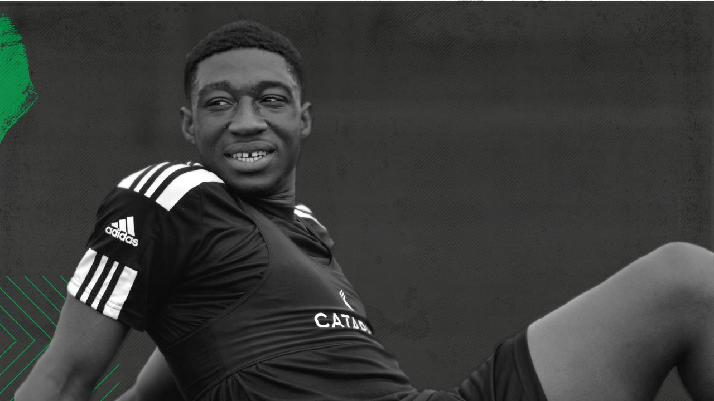
THANK YOU
FOR LISTENING
QUESTIONS?

