Slide 1

Trends in Data
Level 2 vacancies in England Aug and Sept
Level 3 vacancies in England Aug and Sept
 | 2018 | 2019 | 2020 | 2021 | 2022
Aug | 8780 | 6340 | 3670 | 7380 | 4700
Sep | 7620 | 5390 | 4090 | 8610 | 4320
 | 2018 | 2019 | 2020 | 2021 | 2022
Aug | 4730 | 4070 | 3300 | 8940 | 7130
Sep | 4050 | 3780 | 4250 | 6960 | 6090

Slide 2
Trends in Data
Level 2 vacancies in England Aug and Sept
Level 3 vacancies in England Aug and Sept
Meanwhile…..
Higher and Degree Apprenticeship Vacancies
 | 2018 | 2019 | 2020 | 2021 | 2022
Aug | 8780 | 6340 | 3670 | 7380 | 4700
Sep | 7620 | 5390 | 4090 | 8610 | 4320
 | 2018 | 2022
Aug | 570 | 1010
Sep | 380 | 930
After post covid uptick, level 2 vacancies declined to lowest ever levels, whilst level 3 vacancies steadily increased.
Higher and Degree vacancies increased significantly from low base, but many are not advertised on FAA.
 | 2018 | 2019 | 2020 | 2021 | 2022
Aug | 4730 | 4070 | 3300 | 8940 | 7130
Sep | 4050 | 3780 | 4250 | 6960 | 6090

Slide 3
Starts in Norfolk
What does this tell us?
(Considering 2020/21 was COVID Years)
16 to 18 starts are declining year on year
Level 2 starts are also going down year on year.
Level 3 starts are more stable
Starts at 25+ are increasing, as are Higher and Degree Level Apprenticeships.
Conclusions
Despite all the programmes and investments in supporting Apprenticeships for 16- to 24-year-olds, the reforms have created a system where the odds are stacked against this age group.
Government are resistant to further reforms currently despite pressure from education and industry.
Labour recently announced commitment to spend additional money to support Apprenticeships with SME’s.
Toby's speech at the AELP conference - Toby Perkins Labour MP - Toby Perkins MP
Age | 2018/19 | 2019/20 | 2020/21 | 2021/22
16 to 18 | 1440 | 1190 | 870 | 1140
19 to 24 | 1620 | 1390 | 1230 | 1430
25+ | 2670 | 2300 | 2250 | 2550
Level | 2018/19 | 2019/20 | 2020/21 | 2021/22
Level 2 | 2010 | 1530 | 1080 | 1280
Level 3 | 2510 | 2160 | 1930 | 2310
Level 4+ | 1220 | 1200 | 1330 | 1530

Slide 4

Project Update
Just entered the final 6 months of the funded period
Continue to support young people through TrAC, but also via other routes into Apprenticeships.
Volunteer Mentor programme now up and running
Still have the same challenges with provision in some areas, now including engineering.
Quality Issues with training becoming more significant.
Options now are travelling a long way for training or remote learning for some standards.

Slide 5

Project Update
Now has around 100 apprentices employed
Full Flexi Job Status across East, East Midlands and Southeast England
Multi Sector
Quality Framework being introduced by DfE
More competition in the market, but not in Norfolk or Suffolk
Board have recognised the direction of travel with Apprenticeships and are seeking to diversify
Retain existing delivery, but do more to support 16- to 24-year-olds who want to “Earn and Learn”

Slide 6

Introducing
We plan to create learning and earning solutions for those working at level 1 and 2
Work in partnership with training providers
Paid work opportunities alongside accredited learning programmes.
Work will be in a field related to the vocational learning pathway
Fills the void left by Traineeships, but through paid work.
Contract of Engagement rather than Employment
Progression to Apprenticeship at L3

Slide 7
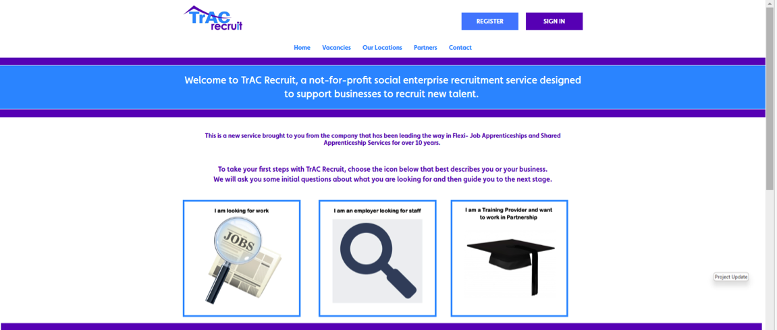
www.tracrecruit.co.uk

Slide 8
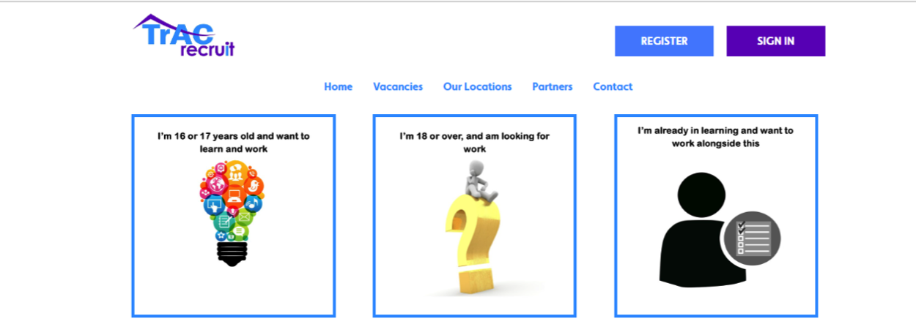
Initial questions keep applications from 16- and 17-year-olds separate to avoid issues with RPA
If 16 and 17’s apply, and are not already in learning, we will work to find them a suitable place to study alongside their work.
Over 18’s on Adult Learning or Skills Boot Camps can also use the service.

Slide 9
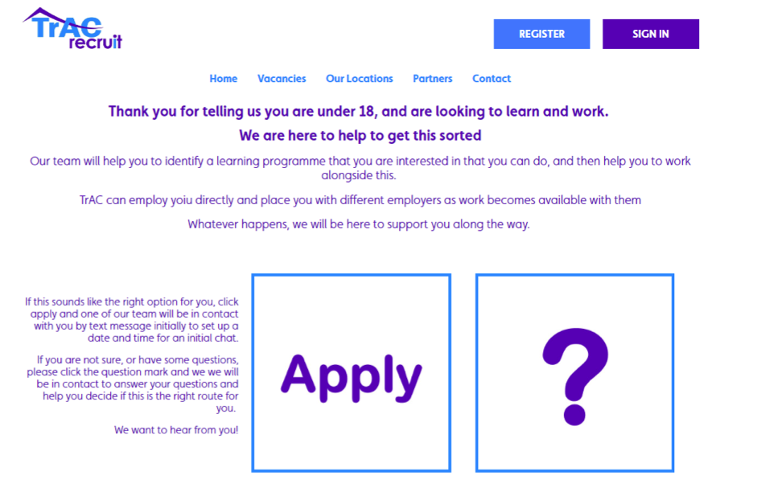
Help or Apply
Young people can apply, or they can complete a form and we will contact them to discuss their options.
We have tried to keep this as simple as possible.

Slide 10
Questions?
Paul Wright 07917 125681
paulw@moorenetworking.net

