Slide 1

T Levels | The Next Level Qualification
Introduction of T Levels - GOV.UK (www.gov.uk)

Slide 2

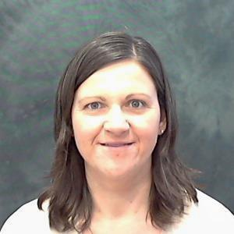
Introduction
Roz Hicks
Head of Media, Business and Digital Industries
Ipswich Road and Paston College

Slide 3

T Levels – what do you know?
Temperature check:
On a scale of 1-10 how much do you think you know about T Levels?
1 = know very little
10 = know practically everything

Slide 4
What are T Levels?
New 2-year Level 3 courses which launched nationally September 2020
Equivalent to 3 A levels and one of the main choices after GCSE alongside A levels and apprenticeships
Developed in collaboration with employers and businesses
Mix of classroom learning and ‘on the job’ experience with an industry placement of at least 315 hours

Slide 5
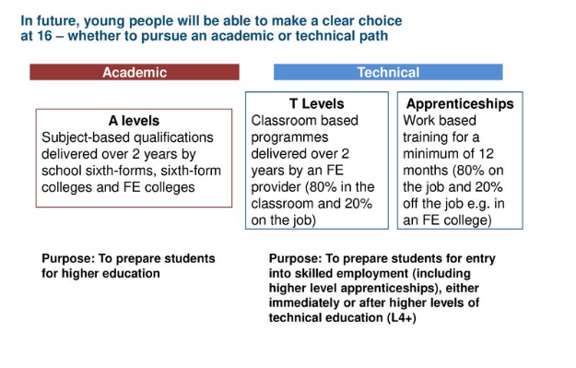
What are T Levels?

Slide 6
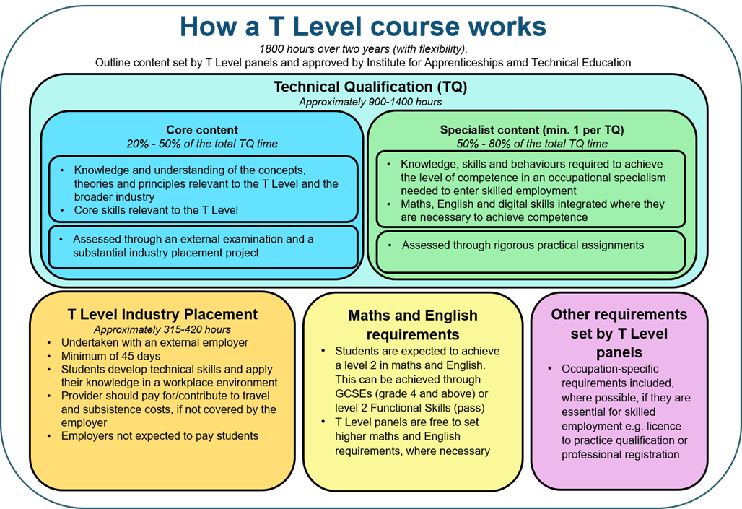
T Level Structure

Slide 7
National Timeline…
September 2020 | September 2021 | September 2022 | September 2023
Design, surveying and planning for construction Digital production, design and development Education and childcare | Building services engineering for construction Digital business services Digital support and services Health Healthcare science Onsite construction Science | Accounting Design and development for engineering and manufacturing Engineering, manufacturing, processing and control Finance Maintenance, installation and repair for engineering and manufacturing Management and administration | Animal care and management Agriculture, land management and production Catering Craft and design Hair, beauty and aesthetics Legal services Media, broadcast and production

Slide 8
T Levels at CCN
As Early Adopters of T Levels in 2020 we set up and delivered:
  Digital Production, Design and Development – Software Engineering
  Design, Surveying and Planning – Construction for the Built Environment
  Education – Early Years

Slide 9
Our Journey so far…
Pass rates​
Design, Surveying & Planning for Construction – 94% (NA 93.7%)​
Digital Production, Design & Development – 100% (NA 89.7%)​
Education & Childcare – 96% (NA 93.4%)​
​
High grades​
94% Merit and above in Construction​
80% Merit and above in Digital Production, Design & Development​
74% Merit and above in Education and Childcare​

Slide 10
Scaling up of our T level offer
Health and Science ​
Science (Laboratory Science OS) 2021​
Health (Adult Nursing OS) 2022​
Health (Mental Health OS) 2022 Planned but not recruited to due to small cohort size​
Education and Childcare​
Education (Early Years Educator) 2020​
Education (Assisting Teaching OS) 2021​
​
Engineering and Manufacturing​
Maintenance, Installation and Repair (Maintenance Engineering Technologies: Mechanical OS) 2022​
Maintenance, Installation and Repair (Maintenance Engineering Technologies: Mechatronic OS) 2022​
Maintenance, Installation and Repair (Maintenance Installation and Repair: Vehicles OS) 2022​
Manufacturing Process and Control (Manufacturing, Processing and control: Fitting and assembly techniques OS) 2022

Slide 11
Scaling up of T level offer
Business and Administration
Management and Administration (Team Leadership/Management OS) 2022 (Paston and Norwich)
Management and Administration (Business Support OS) 2022
Construction
Design, Surveying and Planning (Surveying and deign for construction and the built environment) 2020
Digital
Digital Business Service (Data Technician OS) student recruitment challenges
Digital Support Services (Digital Infrastructure OS) 2021

Slide 12
2023…..
T Level Hairdressing, Beauty & Barbering
T level Professional Catering
??????????

Slide 13
T Level Transitions (PreT)
The T Level Transition Programme is a 1-year post-GCSE study programme designed to support progression to, and success on, a T Level.
It’s aimed at students who would like to do a T Level but would benefit from additional preparation and support before starting one – ie students who miss the T Level entry requirements
The programme gives students the opportunity to study technical content aligned to T Levels and develop their English, maths and digital skills, alongside work experience and personal development.

Slide 14
T Level Transitions
Early Adopters
Education and Childcare Transitions:
  First cohort 2020-21 (13)
  Second cohort 2021-22 (23)
  Level 3 Certificate STL
  Placement (2days per week all year)
Digital Transitions:
  First cohort 2021-22; 5 learners;
  Qualification - BTEC Level 2 Certificate in IT; Placement offered; English/Maths retakes; pathway specific workshops/projects embedded in the curriculum design to support progression
  No Placement (Pandemic)

Slide 15
T Level Transitions
Progression
Education and Childcare Transitions 21/22 cohort:
  21 students completed
  4 progressed to T level EYE
  3 into EYE apprenticeship
  12 into Employment
  2 into HE
Digital Transitions:
  5 learners completed:
  3 progressed to DPDD T Level
  1 progressed to Level 3 DAG
  1 entered employment

Slide 16
T Level Transitions
2022-23
Education and Childcare Transitions:
  3rd Cohort; 25 learners
  Change of qualification L2 Early Years Practitioner following mapping activities with Apprenticeship team. Placement 2 days per week
  English/Maths retakes; pathway specific workshops/projects to be embedded in the curriculum
Health and Science Transitions:
  1st Cohort; 18 learners
  Level 2 Certificate understanding working in the Health Sector
  Placement 1 day per week in term 2 and 3
  English/Maths retakes; pathway specific workshops/projects to be embedded in the curriculum

Slide 17
T Level Transitions
2022-23
Digital Transitions:
  2nd cohort; 21 learners
  Qualification ‘Gateway Level 2 Diploma in Digital and IT Skills’
  Placement offered
  English/Maths retakes; pathway specific workshops/projects to be embedded in the curriculum
  Business Transitions:
  1st cohort; 23 learners; qualification
  ‘NCFE Level 2 Technical Award in Enterprise’
  English/Maths retakes; placement offered; pathway specific workshops to be embedded in the curriculum

Slide 18
ANY QUESTIONS???

