Slide 1
SKILLS FOR ENERGY
Sharing a story: LinkedIn as a tool for marketing and recruitment
Sophie Skipp

Slide 2
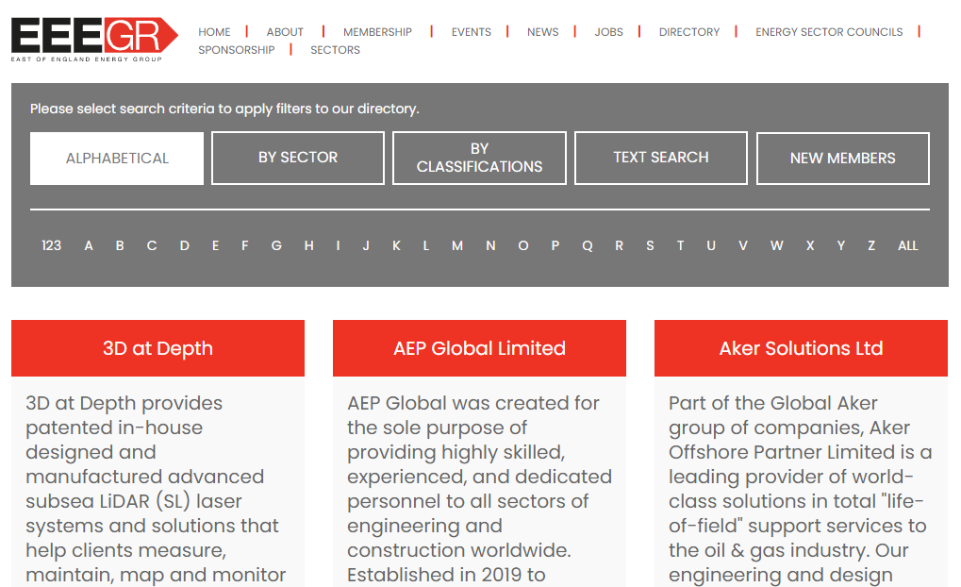

Slide 3
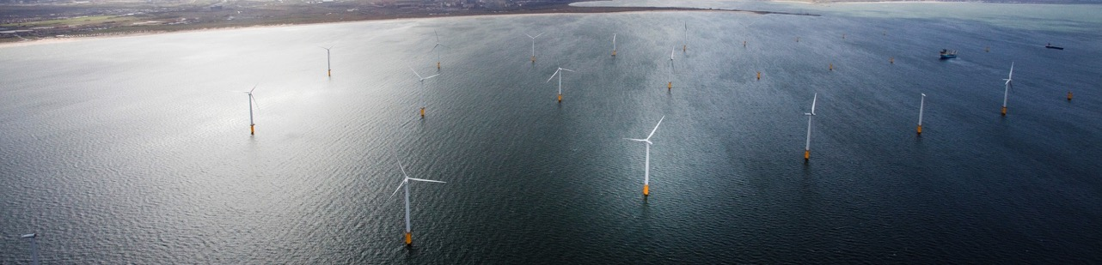




Share Information
Become the go to source for the region’s energy related labour market information and intelligence.
Tell People’s Stories
Amplify our members’ and the region’s voice on energy, people & skills.
Extend Our Reach
Reach the people who are yet to discover energy as their target sector.
Inspire Excellence
Share our best people & skills work and case studies with a targeted audience.

Slide 4
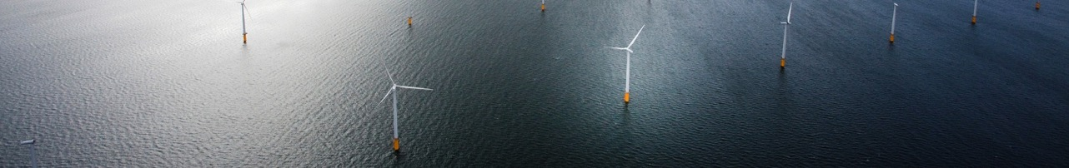



Learner Outcomes
Employer Outcomes
Raise Aspiration
Commitments
Social Value & PR
Magic!
Motivation
Access to Future Target
Make Learning Relevant
Connection
Skills of Future Workforce
Enjoy School Interaction
Notes:
Why are we here?

Slide 5
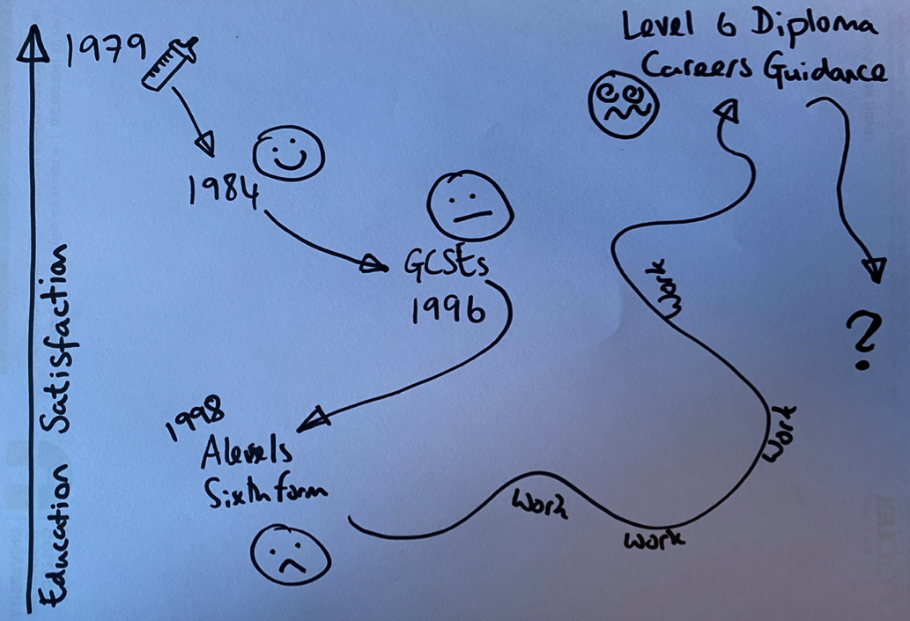
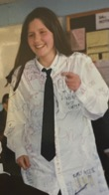
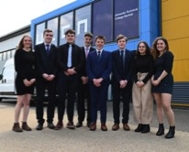

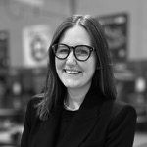



Notes:
Career in sales, marketing and relationship management

Slide 6
My Favourite Subjects/A Level Choices?
English Literature
Theatre Studies
Psychology

Slide 7

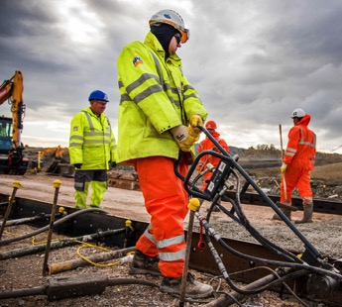
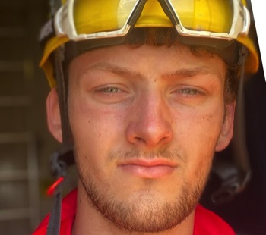


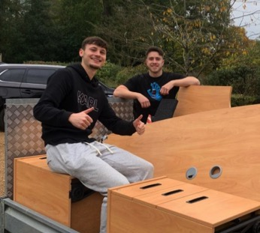
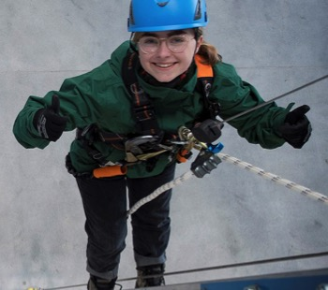
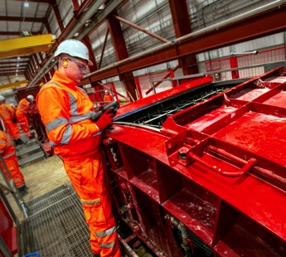


The faces
of energy?

Slide 8
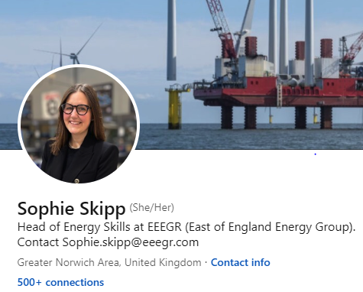
Who Uses LinkedIn?
Facebook for business
Easy to become irritating
People love to bash education, you are different
Stalkers beware!

Slide 9


Sustainability
Long Term Priorities
Economic, Environmental and Social

Slide 10

Project Manger
College Tutor
Who could work in the energy sector?
Cadet
Civil Engineer
Laboratory Scientist
Digital Marketing
Grounds Maintenance
Social Media Manager
Welder
A role for almost every goal!
Mechanic
Business Analyst
Maintenance Technician
Software Engineer
Project Manager
Offshore Wind Turbine Technician
Accountant
Medic
Events Manager
Mechanical Engineer
Cad Design
Construction Management
Communications
Quantity Surveyor
Chef

Slide 11

Economic

Slide 12

Environmental

Slide 13

Social

Slide 14
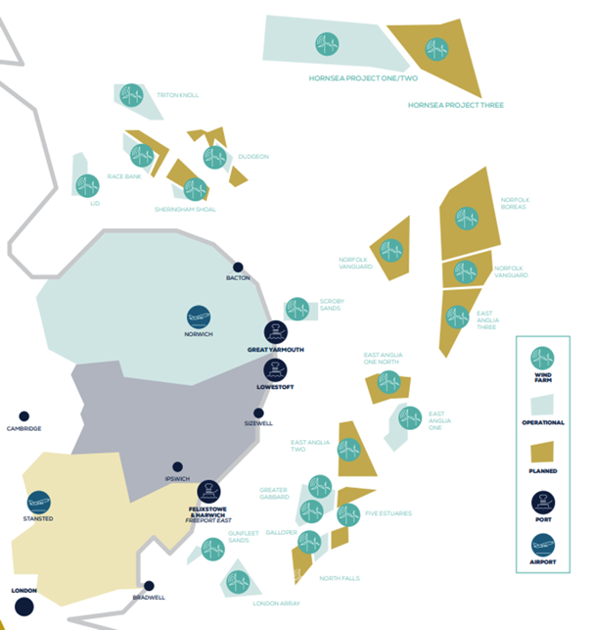
Why East of England?
The Regional is a hot bed for activity in offshore renewables:
  Investment: ~£138 billion capital investment on low carbon power generation by 2050*
  Offshore Wind:
  44% of the UK offshore wind operational fleet based in the Southern North Sea
  54% of the projects with consent are based in the East of England
  Gas: Bacton Gas Terminal supplies 30% of the UKs natural gas
  Ports: Lowestoft and Great Yarmouth have the largest concentration of offshore wind projects in the world within 100 miles of them
  Research & Development: Numerous R&D facilities.
Notes:
Further detail to flag:
OPEX future ways of working
future construction opportunity- net bio-diversity gain/ coexistence
Hydrogen opp around bacton
Clean marine- three active ports
Academic work in region

Slide 15
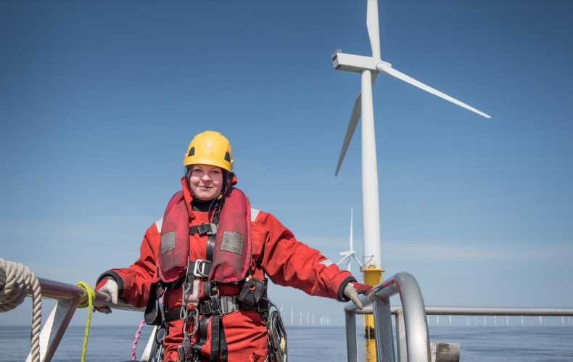

A current workforce figure of 32,257 (an increase of 4% from the 2021 report)
A forecast workforce of over 104,401 by 2030;
A positive trend: 20.6% of our workforce are women (an increase of 4.6% since 2019 and 2.6% since our first report in 2021);
We have surpassed our sector deal target of 2.5% of our workforce being apprentices - we now have 2.6%, and finally;
Of those who provided information on ethnicity, 7% were from non-white backgrounds, compared to 3.8% in 2021.
https://www.owic.org.uk/_files/ugd/1c0521_94c1d5e74ec14b59afc44cebe2960f62.pdf
Notes:
Anglian water, Vattenfall, ceraphi

Slide 16
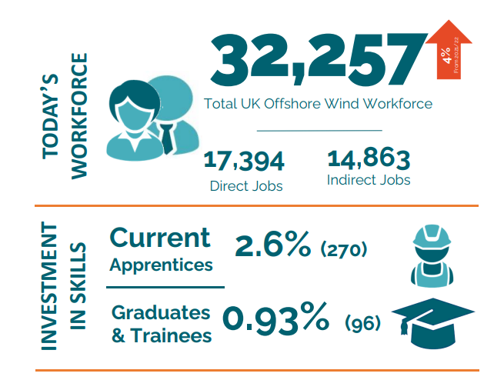

Slide 17
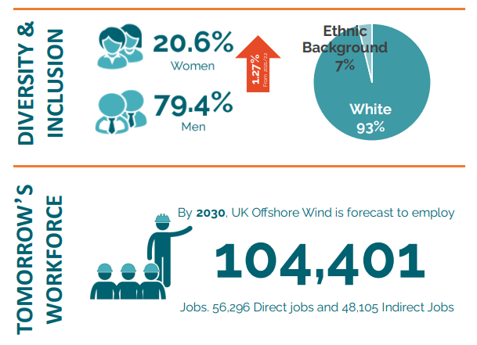

Slide 18
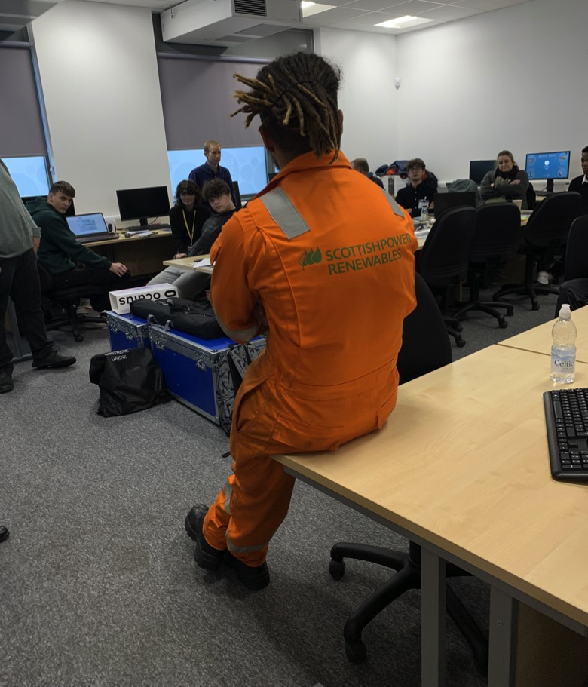

Offshore Wind
Scottish Power Renewables operate vast wind farms in East Anglia:
Create up to 3GW cleaner energy
Up to £6.5bn investment
Powers up to 2.7m homes

Slide 19

Sizewell C
1,500 NEW Apprenticeships

Slide 20
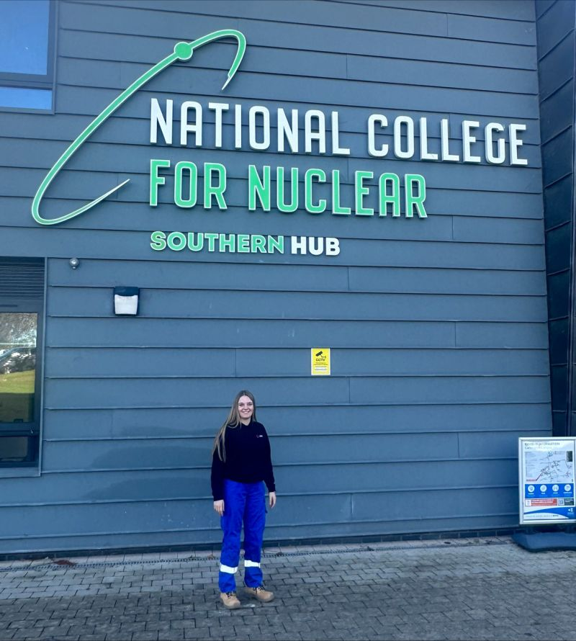
EDF
18 years old
Living in a flat with 4 other young women
Food paid
Accommodation paid
£20,000 per year starting salary
Nuclear engineer
Notes:
Anglian water, Vattenfall, ceraphi

Slide 21
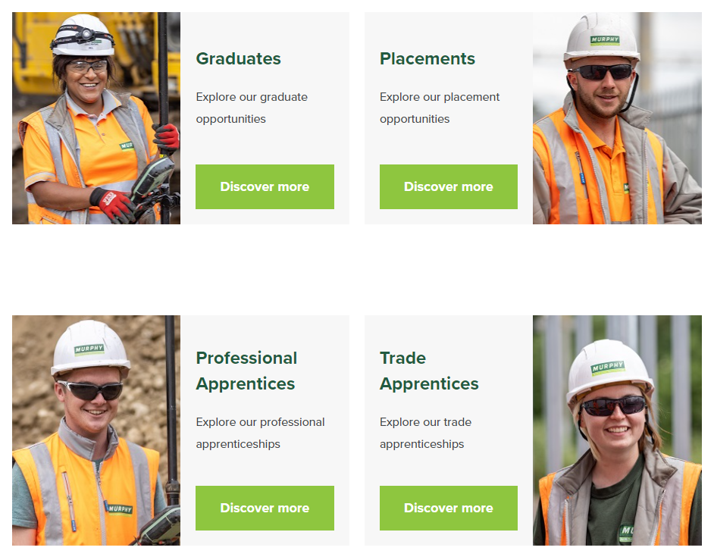


Slide 22
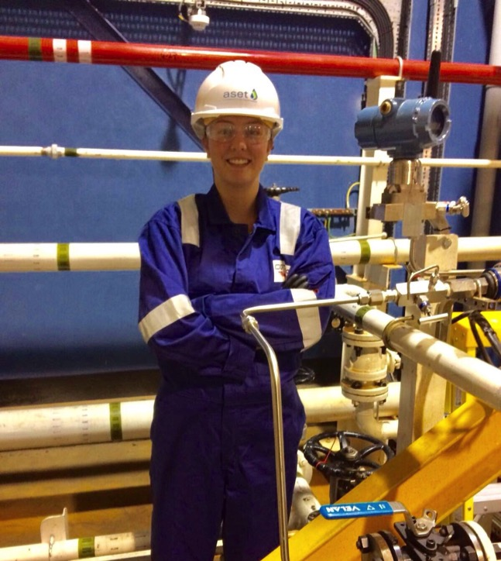
OGTAP
21 years old
3 on 3 off rotation
Starting Salary £19,000
97% chance of role with sponsoring company
Typical £35,000 qualified salary
Food allowance £10 per day
6 weeks holiday
Travel home paid
Notes:
Anglian water, Vattenfall, ceraphi

Slide 23

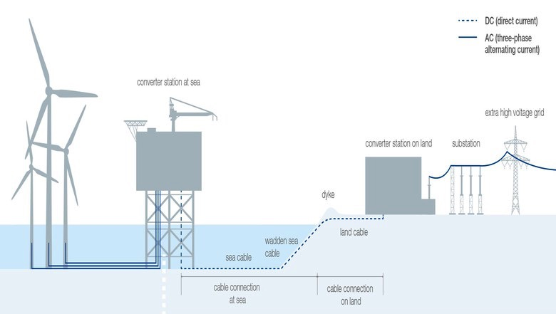

Future Considerations:
Decarbonise extraction of oil and gas
Reducing carbon intensity
Battery technology and balancing the grid
DC (direct current)
Turbine
AC (three-phase alternating current)
Converter station at sea
Extra high voltage grid
Converter station on land
Substation
Dyke
Wadden sea cable
Land cable
Sea cable
Cable connection at sea
Cable connection on land

Slide 24
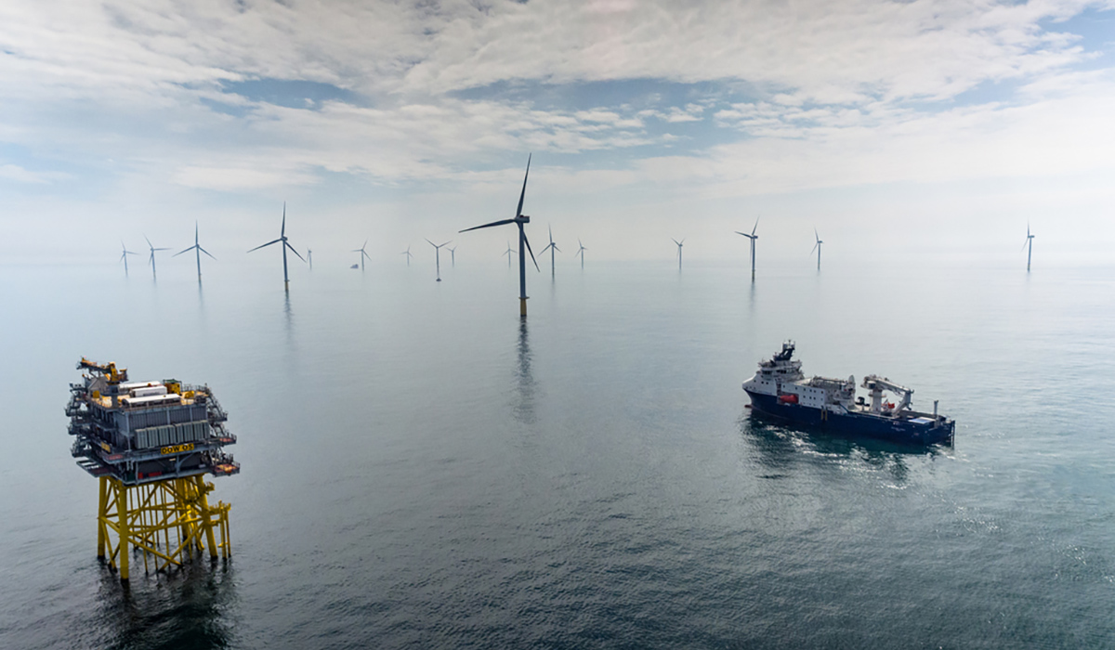


Welding/Fabrication
Planning
Groundworks
Legal/Planning
Crewing Services
Communication
Port Services
Construction
Safety
Safety Equipment
Marine Science
Drones/Surveying
Notes:
How do you use LinkedIn?

Slide 25
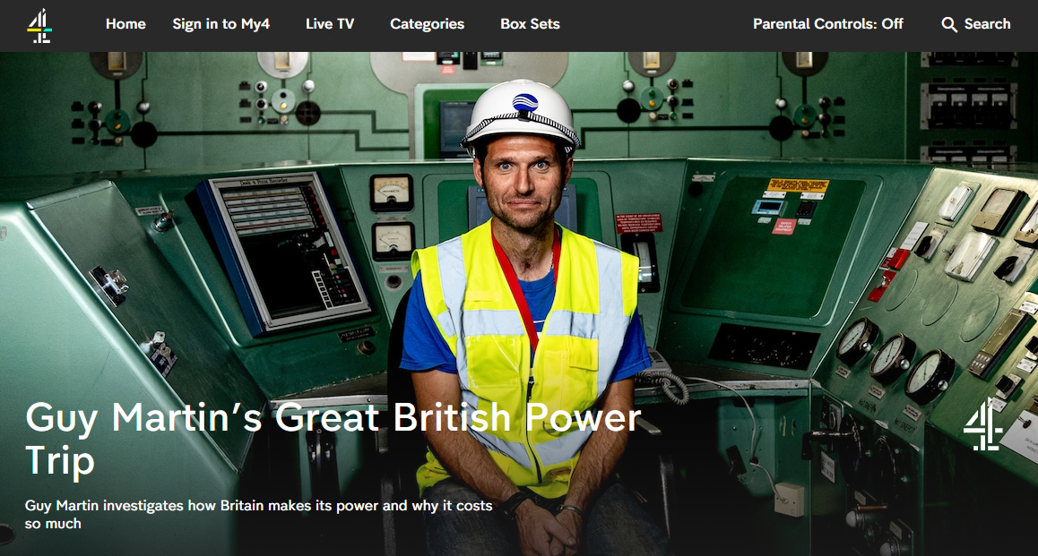

Slide 26
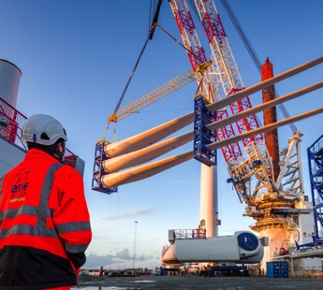

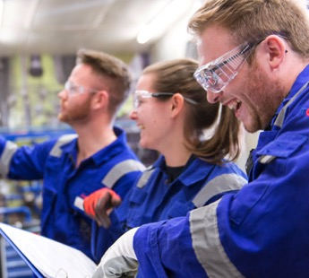

What Next?

Slide 27

Heading
What Next For You?
@skillsforenergy
1.
Explore our members.
2.
Follow Skills for Energy on Instagram.
Visit www.skillsforenergy.com
3.
Ask people for support
on LinkedIn!

