Slide 1

Charlotte Mercer – Deputy Career Development Manager
Jason Winser – Career Facilitator

Slide 2



Career Development Team
Aim to raise awareness & help people Get In, Get On & Go Further in their careers in the NHS
Our remit includes:
    Careers Information, Advice & Guidance
    Work Experience
    Pre-Employment Programmes (Kickstart/T-Levels)
    Step into Health
    Apprenticeships
Notes:
‘Growing Our Own’ skilled workforce to deliver high quality caring services for our patients and local community

Slide 3
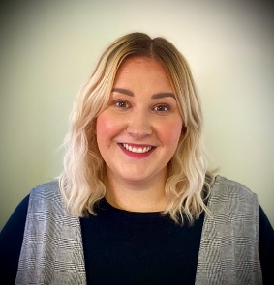
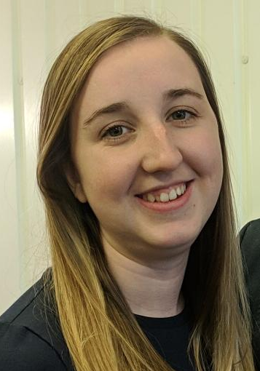
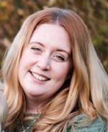
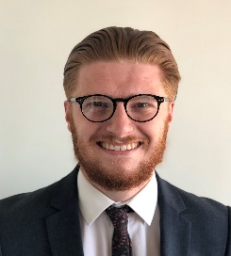
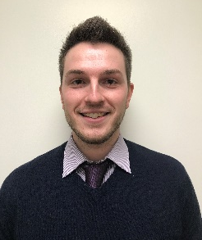

Our Team
Yasmin Willis
Career Development Manager
Charlotte Mercer
Deputy Career Development Manager
Sophie Carter
Pre-Employments Project Lead
Jamie Allison
Career Development Co-ordinator
Kyle Mann
Career Development Administrator
Jason Winser
Career Facilitator
Daisy Hanton
Career Facilitator

Slide 4
Integrated Care System (ICS)
From 1st April 2021, Norfolk & Waveney became an ICS to provide joined-up care
In 2021, the NHS was made up of 219 Trusts (Kings Fund, 2022), in Norfolk this looks like:
Norfolk & Waveney Clinical Commissioning Group (CCG) | Primary Care | Acute Trusts | Community Trusts | Mental Health Trusts | Ambulance Trusts
In charge of 60% of NHS budget - Commission healthcare services in the local area (planning & buying) | GP’s, Dentists, Pharmacies & Opticians | Norfolk & Norwich University Hospital Foundation NHS Trust (NNUH) | Norfolk Community Health & Care NHS Trust (NCHC) | Norfolk & Suffolk NHS Foundation Trust (NSFT) | East of England Ambulance Service NHS Trust (EEAST)
CCG’s may also purchase services from social care / charities / private sector / local authorities if service is not available in the NHS |  | James Paget University Hospitals NHS Foundation Trust (JPUH) | East Coast Community Healthcare CIC
 |  | Queen Elizabeth Hospital (QEH)

Slide 5


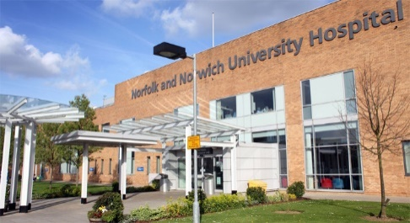
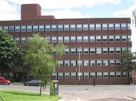
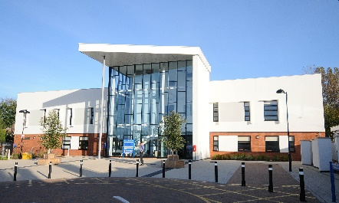
About NNUH
Notes:
Five divisions covering 38 specialities
Approximately 10,000 members of staff, and work in partnership with Serco and our volunteers team
Sites include; NNUH main site, Rouen Road, Cotman Centre, Cromer Hospital, Adelaide Street
Involved in the teaching and training of a wide range of health professionals
Every year our staff treat more than 1,000,000 people!

Slide 6
Benefits of NHS Apprenticeships
Over 350 different careers in the NHS – something to suit everyone!
Apprenticeship salary for 2022/23 - £180 per week, £9,360 (a year)
92% of Apprentices who complete, stay at NNUH
Each Apprentice is assigned a workplace mentor for support
Support from a Career Development Facilitator throughout Apprenticeship

Slide 7


What is great about working at NNUH?
Rewarding career with plenty of variety
Training/career progression opportunities
27 days paid annual leave + bank holidays (increases with length of service)
Excellent pension scheme – employer contributes 20.6%
Local/National NHS discounts in shops/restaurants etc…
Committed to staff Health & Wellbeing
Committed to equality, diversity and inclusion with several networks for Black, Asian, Minority Ethnic, LGBT+ and Diverse Ability
Notes:
Benefits include discounts on food, clothing, childcare vouchers, travel allowance, free park and ride
For more information: https://teamnnuh.co.uk/staff-benefits/

Slide 8
Minimum Requirements
(Entry-level Apprenticeships)
Must be aged 16 or over
Must be a resident in the UK/EEA for the last 3 years
Must not have a qualification at the equivalent or above level in a similar subject
Must not be in any form of formal government-funded education
4 GCSEs at Grade D/3 or above (or equivalent)
All Apprentices are employed on a full-time basis (37.5 hours a week)
Level 2 Apprentices -14 month fixed term contract
Level 3 Apprentices - 20 month fixed term contract

Slide 9
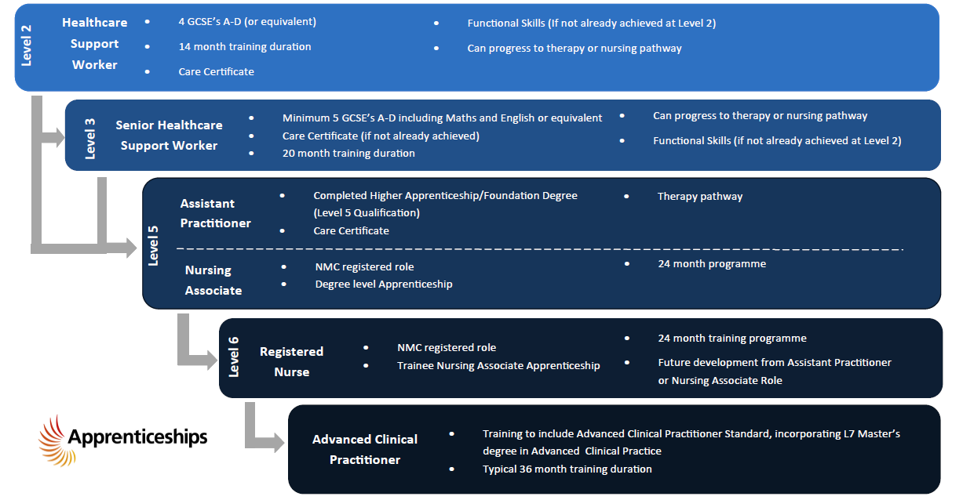
Clinical Career Pathways

Slide 10
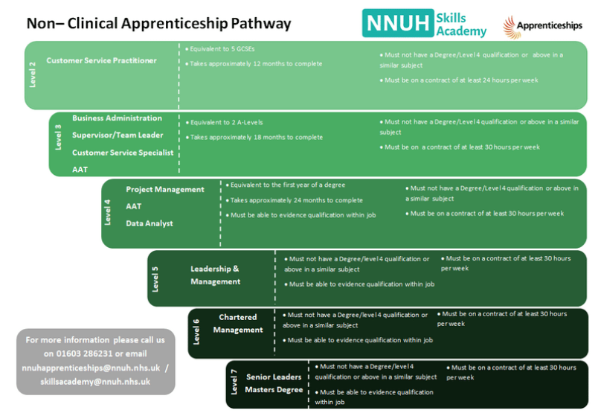
Non-Clinical Career Pathways

Slide 11
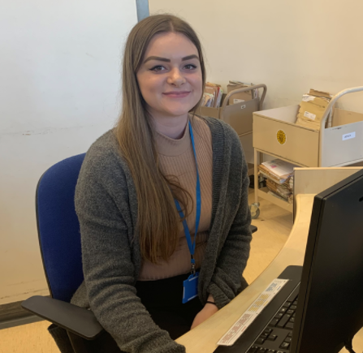
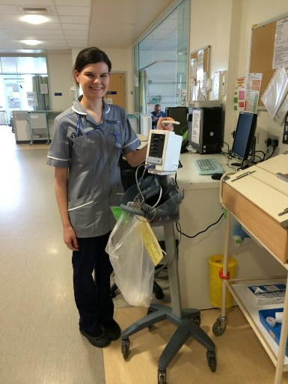
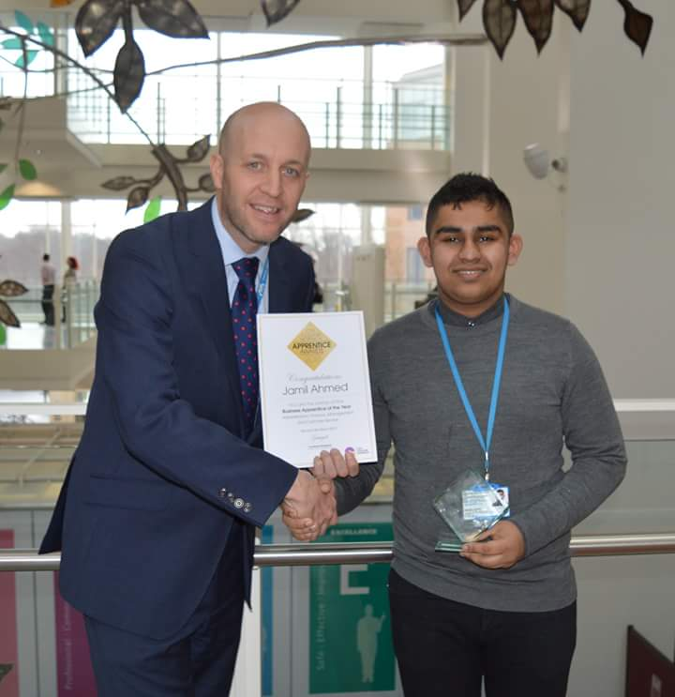
Additional Apprenticeships
Engineering Technician L3
HR Support L3
Laboratory Technician L3
Pharmacy Technician L3
Science Manufacturing Technician L3
Healthcare Science L4
Mammography L4
Commercial Procurement & Supply L4
HR Consultant/Partner L5
Hearing Aid Dispenser L5
Coaching Professional L5
Healthcare Science Practitioner L6
Operating Department Practitioner L6
Notes:
For substantive staff already in relevant roles
As more and more Apprenticeship Standards are developed, we are always looking at ways of how we can incorporate these into our organisation

Slide 12
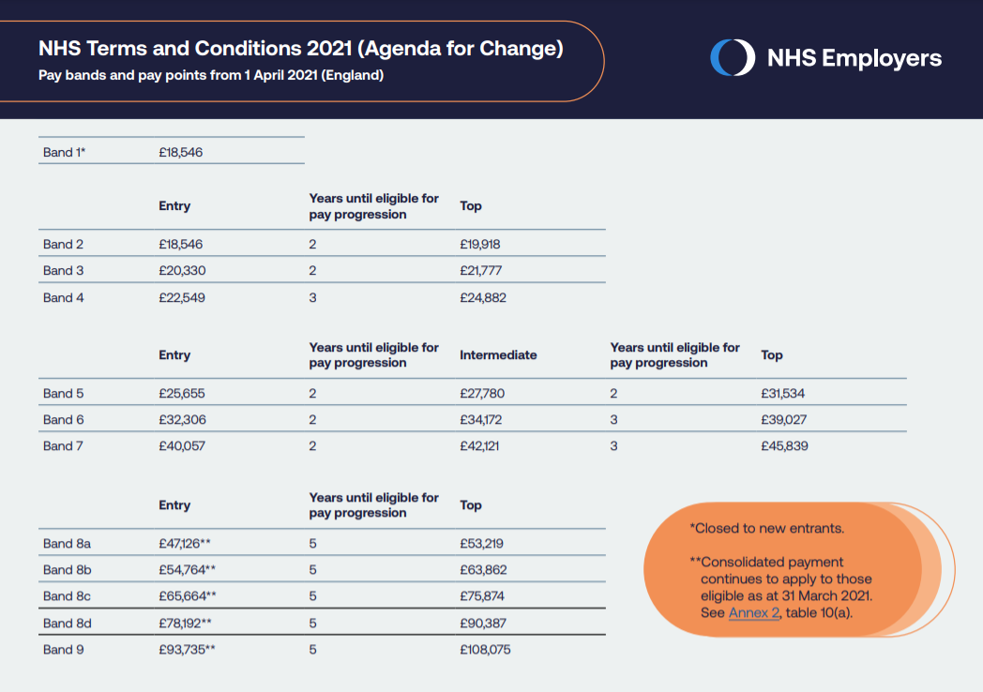
Salaries & Progression
Agenda for Change is the current NHS grading and pay system.
Came into use in 2004.
All NHS staff (except doctors, dentists, apprentices and some senior managers) are paid through AfC.
Fair & progressional pay system

Slide 13
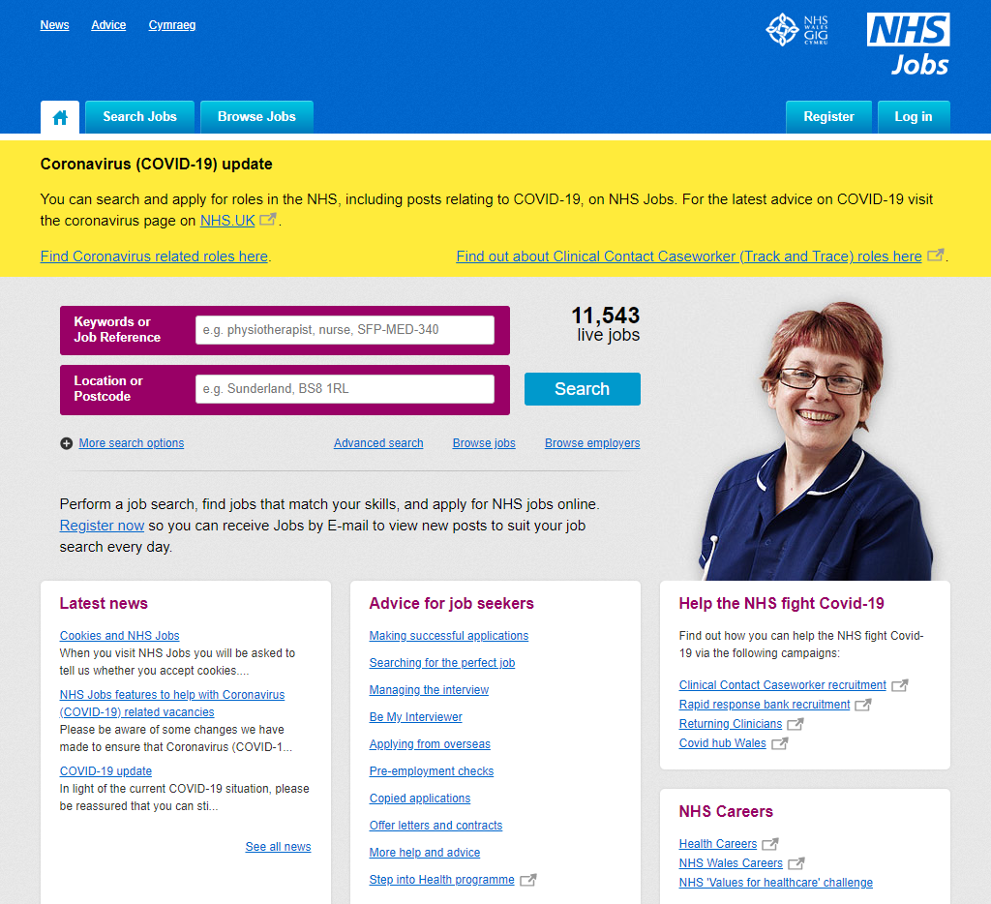
How to apply…
All applications are taken through the NHS Jobs website
You can search for specific jobs and by area using a postcode
Browse jobs by employer
Application and interview tips
Notes:
Applications open 7th – 20th February, interviews w/c 28th Feb

Slide 14

Application & Interview Support
Are you aged 16-30?
Not currently in education, work or training or working less than 16 hours per week?
Need support with your job application?
Need support with preparing for your interview?
Contact - Peter Hennessey, Pre-Employment Projects Co-Ordinator
Peter.Hennessey@nhs.net

Slide 15
Work Experience
No programmes currently planned, however hoping to offer a virtual programme later in 2022.
To register your interest in an ad-hoc work experience placement, please complete this form.
Notes:
Year 7-9 programme & Year 10-12 programme

Slide 16
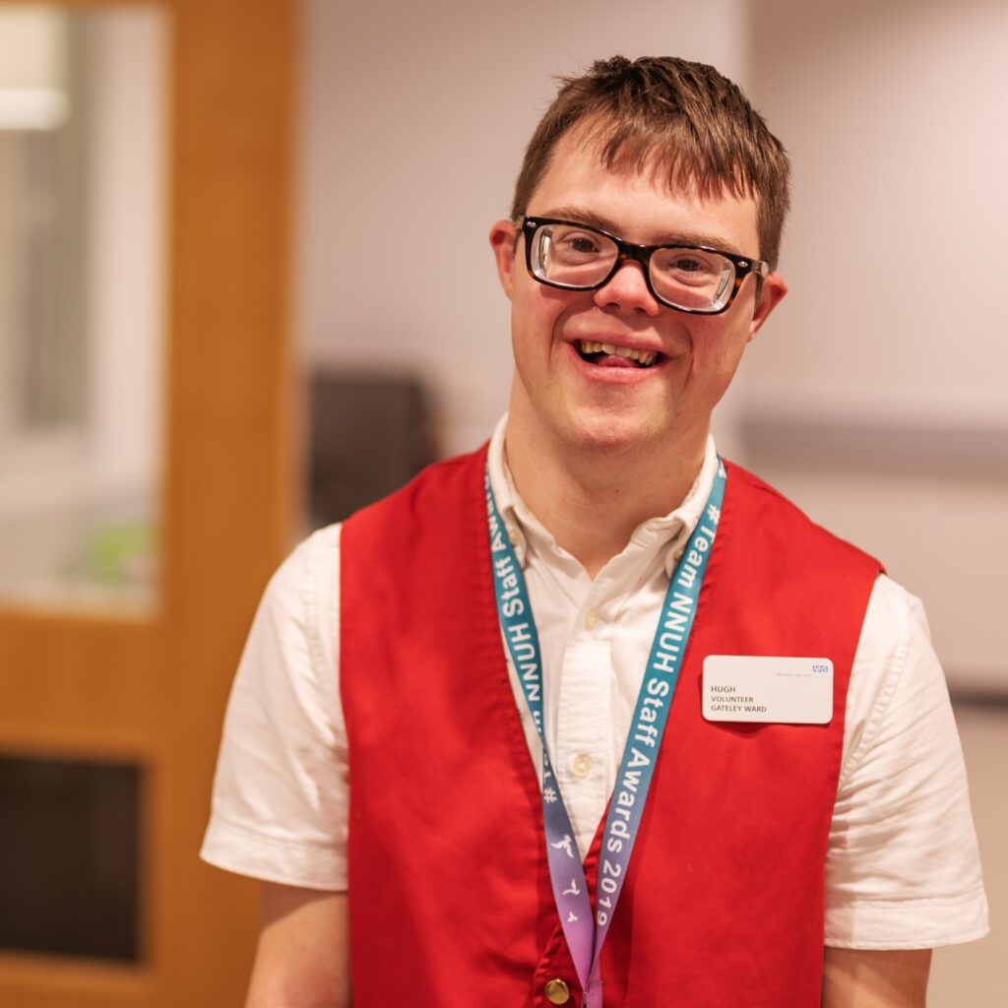
Volunteering
Great way to gain confidence and experience, try something new and a route to employment and to make a real difference in the local community.
50 different roles – Meet & Greet, supporting wards & clinics, bleep buddy, admin/clerical support, reception services, patient experience, settle-in service, transport, butterfly volunteers
All volunteers will be required to undertake a DBS check
Must be aged 16 (non-patient facing) and aged 17.5 (patient-facing)
Apply online
For more information, contact Voluntary Services – 01603 286060
Notes:
APPLICATION PROCESS
Complete Application form
Informal meeting
Recruitment checks
Induction training

Slide 17
Careers Advice Sessions
Twice monthly virtual careers advice sessions held with a member of the Career Development Team
Can receive bespoke advice tailored to your interests (career pathways, apprenticeships, career development, how to get into the NHS)
Dates to be announced soon
Please email nnuhapprenticeships@nnuh.nhs.uk if interested in booking a session

Slide 18
Useful resources
Skills for Health - allows you to see the Apprenticeship Standards at different stages from ‘being explored’ to ‘in development’ & ‘approved for delivery’
Health Careers Quiz – Find an NHS career most suitable for you!
NNUH Skills Academy – for all up-to-date information about our programmes

Slide 19




Contact us!
For general queries, please email Nnuhapprenticeships@nnuh.nhs.uk or call 01603 286231. We also encourage you to follow us on social media for the latest Apprenticeship vacancies and information.
@NNUHCareers
NNUH Apprenticeships and Skills Academy
NNUHSkillsAcademy
NNUHSkillsAcademy

Slide 20
Questions?

