Slide 1

A Week in the World of…
Hospitality
18th – 22nd October 2021
Programme of Events...

Slide 2

Monday 18th October, 2.00-3.00pm
Live Q&A with Patricia Teixeira, Out Reach Co-Ordinator from Springboard UK
Springboard nurture young people into careers in hospitality, leisure and tourism by equipping them with the inspiration, knowledge, skills, advice and guidance they need. They offer award-winning education programmes in schools, colleges and universities and provide specialist careers information, advice and guidance to inform and guide young people. Springboard promote hospitality, leisure and tourism as a great place to work, providing worthwhile and inspirational careers.
Home - The Springboard Charity & Springboard UK
Join Zoom Meeting
https://zoom.us/j/93726734647?pwd=RDJ1cnFBYUlVbDRZbXJEbEJRR2NUZz09
Meeting ID: 937 2673 4647
Passcode: kx18fW

Slide 3

Tuesday 19th October, 2.00-3.00pm
Live Q&A with Richard Fannon of Stower Grange Hotel & Restaurant, Drayton, Norwich
Join us as we talk to Richard Fannon, the Proprietor of Stower Grange, a 3-star, luxury country house hotel in Drayton, just 4 miles from the centre of Norwich. The hotel is set in a 17th century former rectory, and has 11 spacious en-suite bedrooms, a bar and an AA-Rosette restaurant overlooking the gardens. The hotel is open all year round and is licensed to hold civil wedding ceremonies, and also offers meeting and conference facilities.
Stower Grange Hotel, Restaurant & Norfolk Wedding Venue Norwich, Norfolk
Join Zoom Meeting
https://zoom.us/j/99933253465?pwd=UG41MTFjekZrYWtkUEhFUDVpVURmdz09
Meeting ID: 999 3325 3465
Passcode: YDjvK2

Slide 4
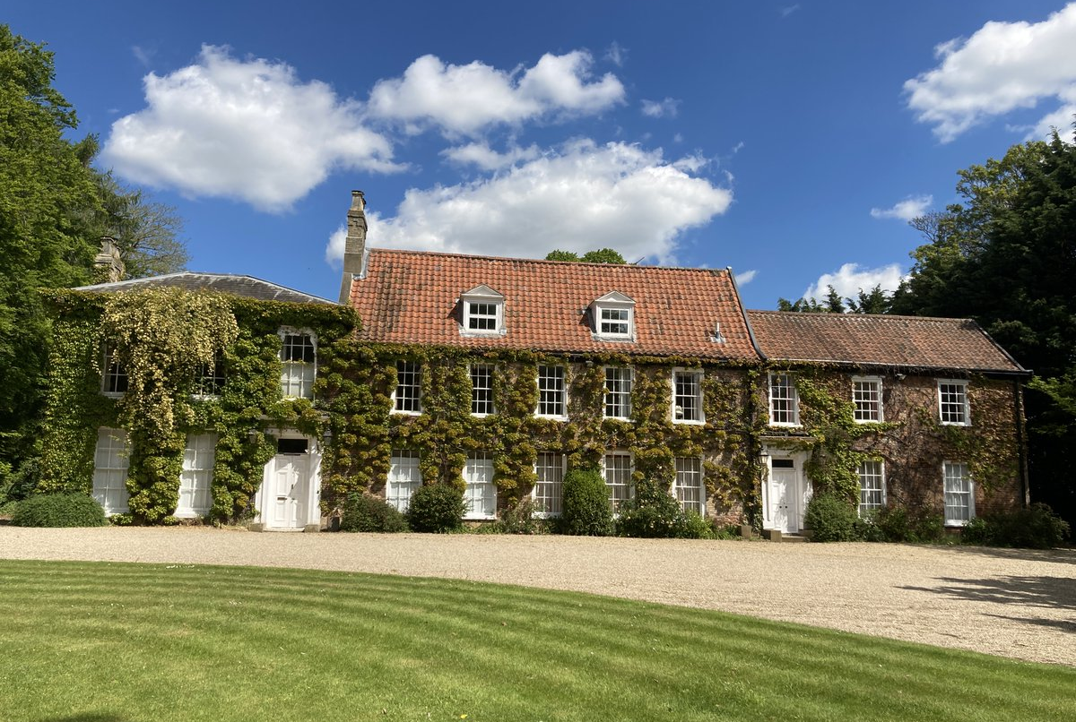
Stower Grange Hotel, Drayton, Norwich

Slide 5

Wednesday 20th October, 2.00-3.00pm
Live Q&A with Christine Malcolm/Georgina Postlethwaite of The Maids Head Hotel, Norwich
Today, we will be joined by either Christine (General Manager) or Georgina (Sales & Marketing Manager) from the Maids Head Hotel. Just over the road from Norwich Cathedral, located in one of the oldest parts of the city, the Maids Head claims to be the oldest hotel in the UK! The oldest parts of the building, above ground, date from the 15th century. The hotel has 84 stylish, en-suite bedrooms and 2 AA rosette The Wine Press restaurant. The hotel also has a bar and the Inside Out Courtyard, which provides a tranquil outdoor space to dine in.
Maids Head Hotel, Tombland, Norwich - Hotel & Wedding Venue
Join Zoom Meeting
https://zoom.us/j/95530634069?pwd=SWFSUjMxY1RRVVBKRmRVK3prSHBWQT09
Meeting ID: 955 3063 4069
Passcode: 3E0pLp

Slide 6
Maids Head Hotel, Norwich

Slide 7

Thursday 21st October, 2.00-3.00pm
Live Q&A with Andrew Shorthose of Kelling Heath Holiday Park, Weybourne nr. Holt
Join us today as we talk to Andrew Shorthose, Deputy Parks Manager at Kelling Heath. Andrew has worked in professional hospitality for 30 years, and joined Kelling Heath Holiday Park just over 2 years ago. We’ll hear about Andrew’s career journey so far, and learn more about the skills he feels are most important for working in hospitality. Set amongst 300 acres of woodland and rare open heathland in an Area of Outstanding Natural Beauty near to the North Norfolk coastline, the park offers woodland lodges and luxury holiday homes to hire, has walks and nature trails, cycle hire, a restaurant, leisure club and swimming pool. Kelling Heath are part of a national scheme for captive breeding of red squirrels, is home to a number of different species of Bats and also has official status as a Dark Sky Discovery Site!
Kelling Heath Holiday Park - Caravan & Camping in Norfolk
Join Zoom Meeting
https://zoom.us/j/98577318717?pwd=aWVMSG4zK3V2V21yalZJdDhxclVRUT09
Meeting ID: 985 7731 8717
Passcode: PiCX16

Slide 8
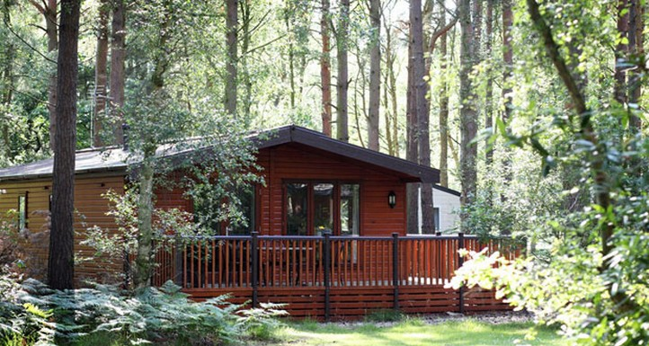
Kelling Heath Holiday Park, Weybourne

Slide 9

Friday 22nd October, 2.00-3.00pm
Live Q&A with Grant Smith, Operations Manager & Director of The Imperial Hotel, Great Yarmouth
Join with us on our final live Q&A this week, when we talk to Grant Smith, Operations Manager and Director of The Imperial Hotel. Learn about Grant’s inspirational career journey from starting work at The Imperial Hotel on Saturdays whilst still at school, progressing onto an apprenticeship, and then through an intensive management training programme to become a Director of the hotel. Located at the relaxed end of Great Yarmouth seafront, the 4-star Imperial Hotel & Restaurant overlooks the beach, sea and Venetian Waterway Gardens. The hotel has a fully glazed terrace with stunning sea views; Bar Fizz and the 2 AA rosettes Café Cru Restaurant.
4 star Great Yarmouth Hotel | Imperial Hotel | Norfolk Hotel & Restaurants
Join Zoom Meeting
https://zoom.us/j/93170420260?pwd=YUFFdVFxaUVIOUh3VUJSanUyay9XQT09
Meeting ID: 931 7042 0260
Passcode: bZ7x53

Slide 10
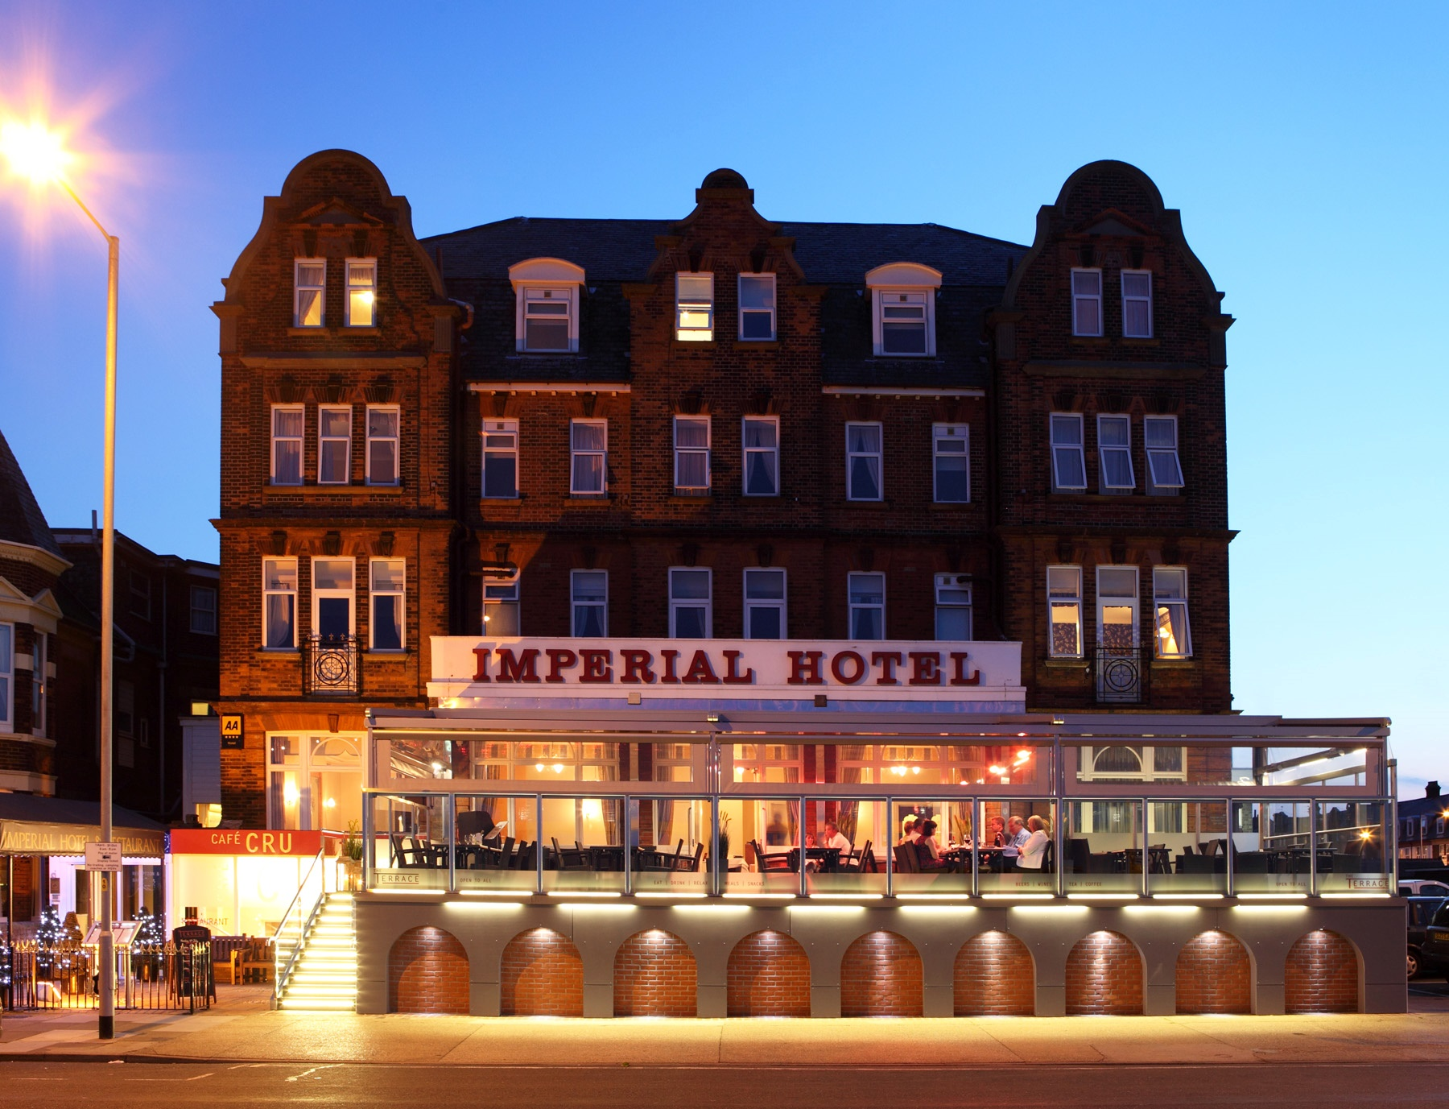
Imperial Hotel, Great Yarmouth

Slide 11
Additional Resources…
Visit our “A Week in the World of Hospitality” playlist on our WEX Norfolk YouTube channel to view videos about all of the venues who are kindly participating this week!
https://youtube.com/playlist?list=PLh1dbUP8t0GYo7R35ZqokK6Avb1yWgiS8
Plus….
Springboard - Springboard success stories - The Springboard Charity & Springboard UK
Imperial Hotel - Grant becomes at Director at Imperial Hotel
Visit the Careermap website for more resources – Careermag - Students & Teachers - Careermap

Slide 12
…and if you can’t join us on the day?
Live Q&A sessions will also be recorded and uploaded to our YouTube channel at the end of the week, so if you’re not able to join us live, you can watch the session at a later date on the same dedicated playlist at:
https://youtube.com/playlist?list=PLh1dbUP8t0GYo7R35ZqokK6Avb1yWgiS8
Please feel free to view video resources as many times as you like, but we ask that you do not share any resources outside of the school environment or on any social media platforms. Thank you.

