Slide 1

Digital careers in Norfolk and Suffolk
BEACON East event
Tim Robinson, Chief Operating Officer, Tech East
2 December 2022

Slide 2

What digital jobs initiatives are available at the moment? A selective snapshot!
@NewAngliaLEP
Digi-tech Factory @CCN
Bootcamps
Degrees
Apprenticeships
ESF Programme (UoS: ICET)
T levels
Tech Campus @Suffolk New College
Digi Tech Centre @UoS
Notes:
2

Slide 3

Impact of COVID-19 pandemic on digital/ICT
Challenges include:
Increased hiring and salary costs for businesses– flattening of global tech jobs market with move to ‘work from home’ and hybrid working – our local tech talent has the world as its oyster
Persistent regional under-achievement in STEM qualifications, particularly at the higher end of the spectrum
Opportunities include:
COVID lockdowns put the digital sector further into the spotlight as businesses transition to homeworking, and people look for new ways to work, learn, shop, consume entertainment and socialise virtually.
There is huge potential for the sector to grow even faster particularly around AI, Virtual and Augmented Reality (aka the metaverse), blockchain, connected devices (IoT) and the increasing automation of all industries
Notes:
Wages rising but due to national context, this may continue (they are currently tracking lower esp in digital industry)

Slide 4
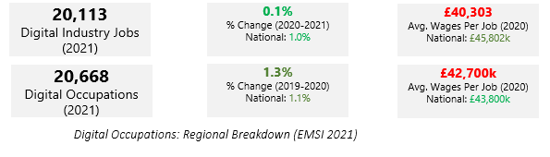
How does the region track the rest of the UK?
In 2020, the total number of people working in digital/ICT sector in New Anglia was up (0.1%) from the previous year but below the national growth rate of 1%
The total number of people working in digital occupations was slightly higher (1.3%) than the previous year and above the national change (1.1%).
Average wages in the digital/ICT sector in New Anglia are below the national average
Notes:
Digital Occupations include cross-industry roles classed as ‘digital’. Digital Industry – focussed on occupations within the digital sector.
Key points: Digital Occupations growing at faster rate than digital industry roles/ both below national wage rates with digital industry lower than digital occupations – gap higher for digital industry!

Slide 5
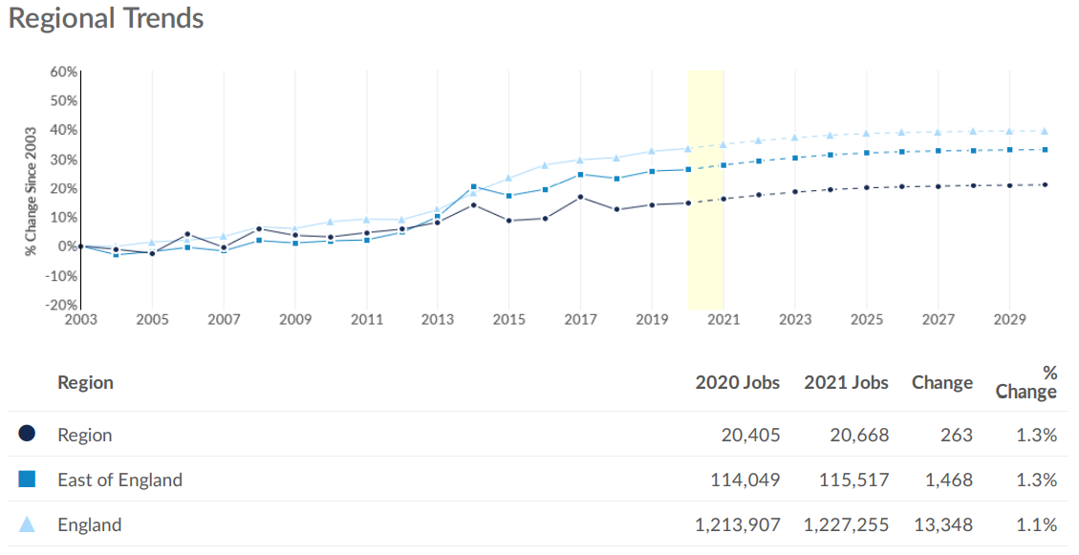
Employment in digital/ICT occupations
Regional trends in digital employment follow East of England and national trends closely with steady increases from 2018 to 2022
Forecast to continue increasing
In East of England (and New Anglia) we have seen slightly higher increases in demand vs national demand in the last year
Notes:
Trend is growing – will this impact further on wages?

Slide 6
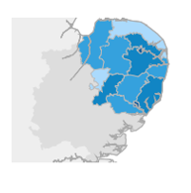
Local employment data (digital/ICT occupations)
ICT/digital job postings in New Anglia - up from an average of 700 postings per month Jan to Sept 2021 to more than 1500 postings per month in Jan/Feb 2022 (an increase of 115%)
Local authority | 2020 (total ICT job postings) | 2021 (total ICT job postings)
Norwich | 4,557 | 7,457
Ipswich | 3,004 | 5,349
St Edmundsbury | 1,077 | 1,256
South Norfolk | 681 | 652
King’s Lynn | 362 | 530
Notes:
Suffolk Districts
ICT job postings in Suffolk - up from an average of 700 postings Jan to Sept to 1500 in Dec 2021 (115%)
Ipswich - 300 (J-S) to 650 (Dec) (117%)
Babergh - 30 (J-S) 160 (Dec) (433%)
Forest Heath - 35 - 65 (85%)
Mid Suffolk - Steady growth from Jan ave of 50 to 175 in Dec (with dip over 3 Summer months) (250%)
St Edmundsbury - 70 - 140 (100%)
Suffolk Coastal - 125 - 275 (120%)
Waveney - 17 - 35 (106%)

Slide 7
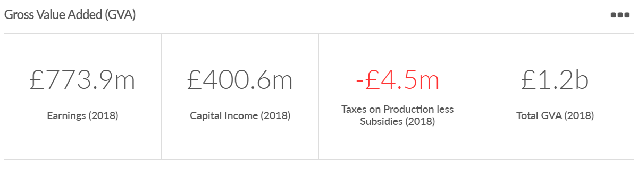
GVA of the digital/ICT sector
Total Suffolk and Norfolk GVA for 2018 was £27.6bn (of which 4.3% digital/ICT sector)

Slide 8
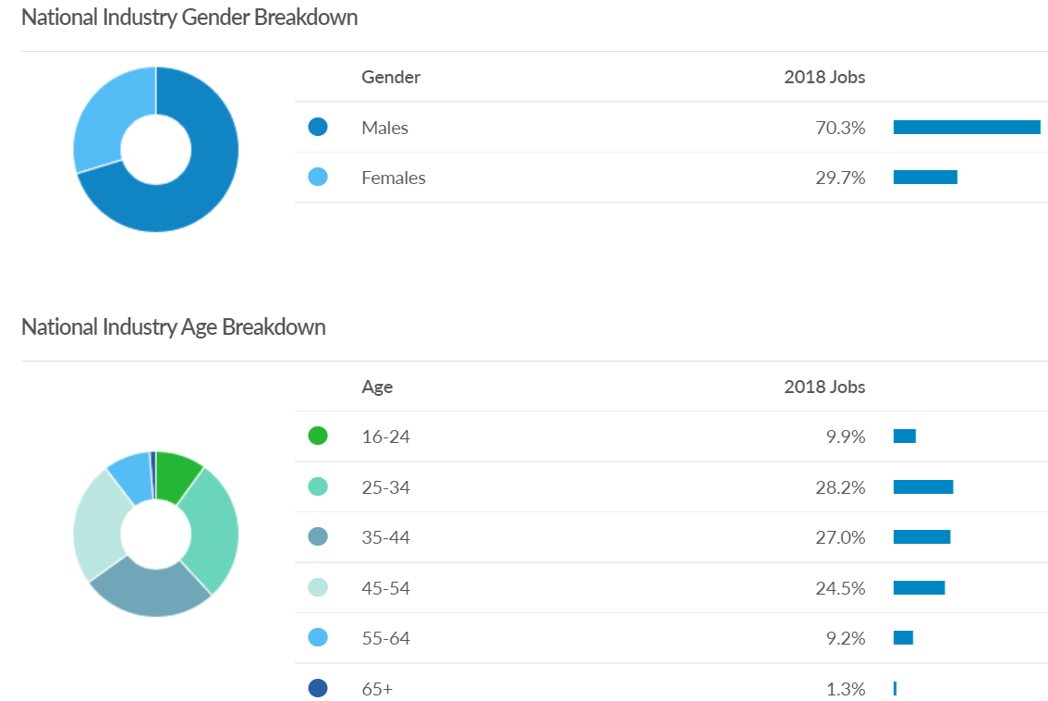
Diversity in digital/ICT sector (whole of UK)
Notes:
Wave 1 Bootcamps have increased diversity in levels of digital training in BC trailblazer areas

Slide 9
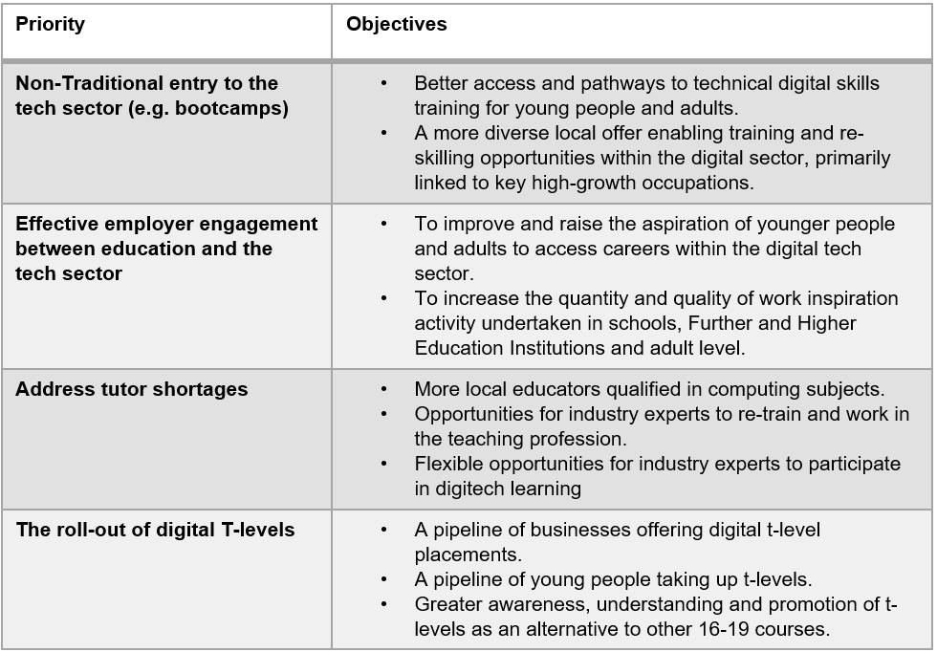
Digital Skills Taskforce - priorities

Slide 10

Any questions?
Presentation for Hot House
March 2022

