Slide 1
preparing young people for work: what really works in career guidance?
Norfolk Careers & work-related network
22 March 2022
Dr Anthony Mann, OECD
Twitter: @AnthonyMannOECD
Notes:
Andreas

Slide 2








Introduction …over the last 20 years…

Slide 3
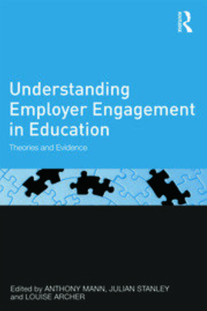

Introduction …over the last decade…
‘Employer engagement in British secondary education: wage earning outcomes experienced by young adults’
‘The ‘Employer Engagement Cycle’ in Secondary Education: analysing the testimonies of young British adults’
‘Career education that works: an economic analysis using the British Cohort Study’
‘Schools and the twenty-first century labour market: perspectives on structural change’
‘Socialised social capital? The capacity of schools to use careers provision to compensate for social capital deficiencies among teenagers’

Slide 4
Over the next forty minutes or so…
The youth employment challenge
New OECD work on how career guidance activities can be seen to improve employment outcomes for young people
  What we did
  What we found
  What we see as the implications are for schools
Project website: https://www.oecd.org/education/career-readiness/
Twitter: @AnthonyMannOECD
Linked-In: Anthony Mann
Notes:
Welcome from Andreas
English perspective from Susan
Results from Catalina
Implications and next steps from Anthony
We are joined today by colleagues from the EDPC, CERI, GNEVET, ELS, from national ministries and agencies and from international organisations.
Colleagues will already have received a short publication setting out the approach of the Career Readiness in the Pandemic project and the results.
The brochure reports results from three working papers, two that have been published already and a third that will be published next week.
Invite Susan Acland-Hood to introduce the topic from a UK perspective.

Slide 5
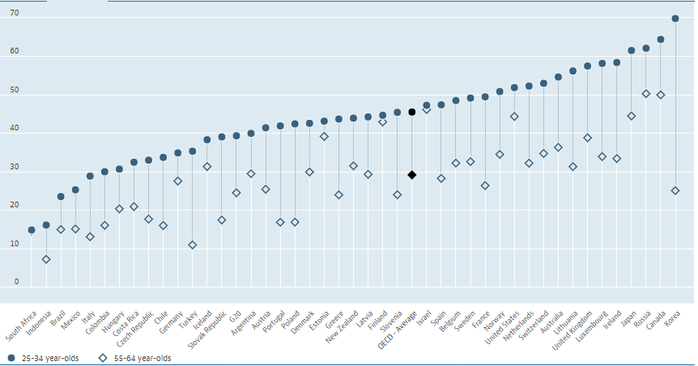
Young people in the UK are more educated than ever

Slide 6
…but their competiveness for available jobs is weak…
Notes:
Andreas
Young people are always at a disadvantage in the competition for work. In spite of often being more highly qualified than older people, they have less experience of the workplace, fewer contacts and less know-how about how to secure a job.
We see this is in consistently higher unemployment rates for young people under 25 compared to older people.
The ratio is only marginally different from preceding years.

Slide 7
…and they are especially vulnerable in a crisis.
Notes:
Between 2007 and 2013 the youth unemployment rate in the UK rose from 14.3% to 20.8%

Slide 8
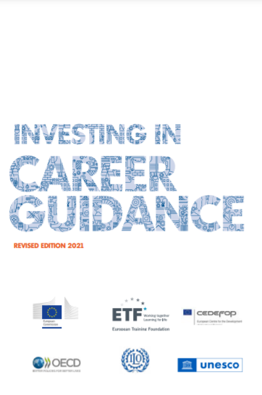
More important than ever: the case for career guidance.
Globally, young people are staying in education longer
than ever.
They have more decisions to make than ever before.
Those decisions are becoming more difficult
because the labour market is becoming more turbulent &
continuing education more marketised.
We look to career guidance to help students visualise and plan their
futures …. but what can be relied on to work, especially in
periods of economic turbulence?

Slide 9
We used longitudinal data to test what works in career guidance
To gather information that is seen as most reliable:
we need to follow students over time to see if they do better later on than if they hadn’t engaged in guidance
after taking account of the characteristics that influence how people do in work (gender, academic achievement, social background, geographic location), we look for statistically significant relationships (10%) between better outcomes and teenage experiences and attitudes.

Slide 10
We used longitudinal data to test what works in career guidance
Longitudinal surveys follow large numbers of children into adulthood, interviewing them (and sometimes their parents and teachers) regularly, collecting information on the characteristics that typically influence better employment transitions.
In the UK:
British Cohort Study (BCS)
Longitudinal Study of Young People in England (LSYPE)
Millenium Cohort Study

Slide 11
Career Readiness in the Pandemic
We looked at available datasets in Australia, Canada, China, Denmark, Germany, South Korea, Switzerland, United Kingdom, United States and Uruguay.
An initial literature review identified 14 potential career-related experiences and attitudes typically measured at age 15.
Looking at the datasets, we wanted to know if statistically significant relationships were found between these potential indicators/ predictors with three outcomes: lower NEET rates, higher wages, greater job satisfaction typically at age 25.
We then integrated our new findings into the existing research literature.

Slide 12
New longitudinal analyses: the datasets
Country | Data collection period | Baseline data collection | Age at baseline data collection | Follow-up source (surveys) | Age at last follow-up | Sample size at last follow-up
Australia | 2010 to 2019 | PISA 2009 | 15-16 | Longitudinal Surveys of Australian Youth (LSAY) | 25-26 | 2933
 | 2004 to 2013 | PISA 2003 | 15 |  | 25 | 3741
Canada | 2002 to 2010 | YITS & PISA 2000 | 15 | Youth in Transition Survey-Reading Cohort (YITS) & The T1 Family File (T1FF) | 25, 29-30 | 10927
China | 2012 to 2018 | CFPS 2010 (in 'Thinking about the future'); CFPS 2014 (in 'Experiencing' the future) | 10 to 15 (Thinking); 14 to 18 (Experiencing) | China (People’s Republic of) Family Panel Studies (CFPS) | 18-23 (Thinking); 18-22 (Experiencing) | 2078 (Thinking); 1210 (Experiencing)
Denmark | 2011 to 2012 | PISA 2000 | 15 | OECD Programme for the International Assessment of Adult Competencies [PIAAC] | 26/27 | 1881
Germany | 2010 to 2018 | NEPS Starting Cohort 4 2010-2011 | 14 to 16 | The National Educational Panel Study (NEPS) | 23-25 | 5589
Korea | 2006 to 2018 | KELS 2006 | 14/15 | Korean Education Longitudinal Study 2005 (KELS2005) | 25/26 | 3720
Switzerland | 2001 to 2007, 2010, 2014 | PISA 2000 | 15 | Transitions from Education to Employment (TREE 1) | 25 | 3423
United Kingdom | 1996, 2004 | BCS70 - 1986 | 16 | British Cohort Study (BCS70) | 26 | 4547
 | 2005, 2006, 2007, 2015-16 | LSYPE 2004 (February) | 14 | Longitudinal Study of Young People in England (LSYPE) | 25-26 | 7707
United States | 1997 to 2011 | NLSY79 - 1997 | 12 to 16 | National Longitudinal Survey of Youth 1997 (NLSY97) | 25-29 | 5466
 | 2004, 2006, 2012 | ELS - 2002 | 15 | The Educational Longitudinal Study (ELS) | 25 | 13250
Uruguay | 2007, 2012 | PISA 2003 | 15-16 | Uruguayan Longitudinal Study (PIS03-UYLS) | 24-25 | 2451

Slide 13
Longitudinal data: some limitations
Not every country has longitudinal data
Data is necessarily old – BCS kids are my age!
We can’t ask new questions – we have to rely on what the research teams decided and this can cause frustrations!
When comparing them, you have to focus on what is most comparable
Sample sizes fall over time sometimes causing problems
Because they are complicated, many of the datasets we looked at were analysed by different experts using different methodological approaches

Slide 14
We published our results in three OECD papers
Mann, A. et al. (2020), Career ready?: How schools can better prepare young people for working life in the era of COVID-19
Covacevich, C., et al. (2021), Thinking about the future: Career readiness insights from national longitudinal surveys and from practice
Covacevich, C., et al. (2021), Indicators of teenage career readiness: An analysis of longitudinal data from eight countries

Slide 15
Overview of results: 11 career readiness indicators
Better employment outcomes around age 25 are associated with the following teenage activities, experiences and attitudes around the age of 15:
Exploring the future | Experiencing the future | Thinking about the future
Engaging with people in work through career talks or job fairs | Part-time working | Career certainty
Workplace visits or job shadowing | Volunteering | Career ambition
Application and interview skills development activities |  | Career alignment
Occupationally-focused short programmes |  | Instrumental motivation towards school
Career conversations – inc. with teachers
…and probably | …and probably | …and probably
School-based career reflection activities, including career questionnaires & career classes | Work placements | Career originality

Slide 16
Exploring the future
Indicator | Studies that find beneficial and significant associations | Positive associations found in | Examples
Engaging with people in work through career talks or job fairs | 4 out of 7 studies from 6 countries | Australia, Canada, United Kingdom, Uruguay | In Uruguay, individuals who had attended a career talk by age 15 were 3 percentage points less likely to be NEET at age 25
Workplace visits or job shadowing | 4 out of 6 studies from 6 countries | Australia, Canada, Korea, United States | In Korea, individuals who had visited a job site or factory at 15 were 1.23 times less likely to be NEET at 25
Application and interview skills development activities | 3 out of 4 studies from 4 countries | Australia, Canada, United Kingdom | In the United Kingdom, individuals who felt they had working knowledge of completing job application forms by age 16 experienced an average of 1.5 months less unemployment by the age of 26
Occupationally-focused short programmes | 14 out of 17 studies from 3 countries | Australia, Canada, United States | In Canada, individuals who participated in occupationally-focused short courses by age 15 earned 3% more at age 30
Career conversations – inc. with teachers | 7 out of 10 studies from 6 countries | Australia, Canada, United Kingdom, United States | In the United Kingdom, individuals who had a career conversation with a teacher aged 14-16, had a 0.11 point increase in the life satisfaction 0-10 scale aged 26
…and probably
School-based career reflection activities, including career questionnaires & career classes | 2 out of 7 studies from 6 countries

Slide 17
Experiencing the future
Indicator | Studies that find beneficial and significant associations | Positive associations found in | Examples
Part-time working | 20 out of 27 from 6 countries | Australia, Canada, United Kingdom, United States | In the United Kingdom, individuals who had experience of paid work by age 16 earned 6% more in weekly wages at age 26 relative to comparable peers who did not by age 16
Volunteering | 8 out of 9 studies from 5 countries | Australia, Canada, Germany, United Kingdom, United States | In the United Kingdom, individuals who volunteered by age 16, experienced 0.6 fewer months of longest unemployment duration by age 26 than comparable peers who reported not having experience of volunteering by age 16
…and probably
Work placements | 2 out of 5 studies from 4 countries

Slide 18
Thinking about the future
Indicator | Studies that find beneficial and significant associations | Positive associations found in | Examples
Career certainty | 15 out of 20 studies from 9 countries | Australia, Canada, Denmark, Switzerland, United Kingdom, United States | In the UK, individuals who were career certain at 16 had an increase of 0.12 points in the 0-10 life satisfaction scale at 26 relative to comparable peers who were uncertain
Career ambition | 15 out of 19 studies from 9 countries | Australia, China, Korea, Switzerland, United Kingdom, United States | In Korea, ambitious teenagers earned 5% more at age 25/26
Career alignment | 9 out of 11 studies from 7 countries | Australia, Canada, China, Korea, United Kingdom, United States | In Australia, individuals who were aligned as teenagers earned 8% more at age 25/26 than the average earnings
Instrumental motivation towards school | 13 out of 15 studies from 8 countries | Australia, Canada, Denmark, Korea, United Kingdom, United States | In the United Kingdom individuals who strongly agreed that school was a waste of time at age 14 were 9 percentage points more likely to be NEET at age 25/26 (than those who strongly disagreed)
…and probably
Career originality | 2 out of 4 studies from 4 countries

Slide 19
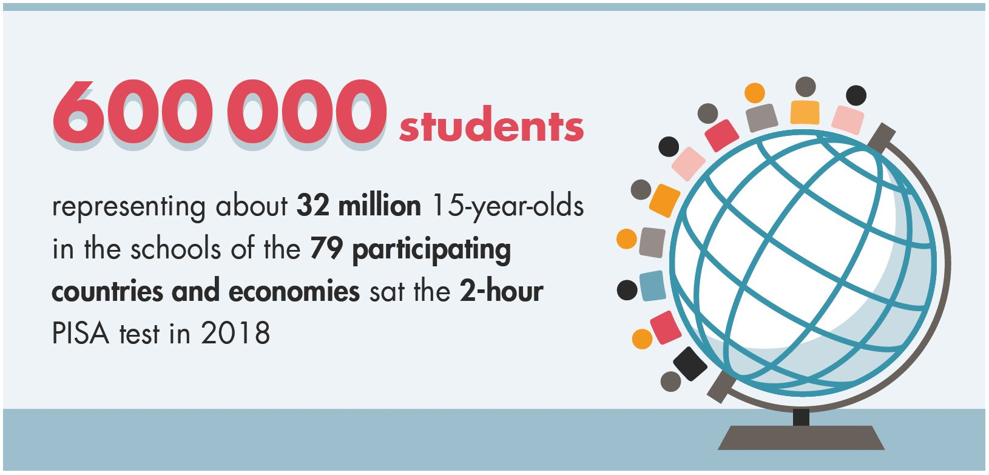
PISA 2018
but also responded to questions about their aspirations for their future careers, and from where they learn about the world of work
Notes:
PISA asked all responding students from 79 countries and economies: What kind of job do you expect to have when you are about 30 years old?
In addition, students from 32 countries and economies undertook the Educational Career Questionnaire which collected data on participation in career development activities (i.e., internships, job fairs, meeting with career counsellors) and career related skills development (i.e., résumé development, interview skills).

Slide 20
Career readiness in the UK: insights from PISA 2018
Career expectations at 15-16
 | Girls |  |  | Boys
1 | Teachers | 8.7 | 1 | Engineers | 10.0
2 | Doctors | 8.6 | 2 | Sportspeople | 7.2
3 | Lawyers | 8.5 | 3 | ICT professionals | 7.0
4 | Nursing and midwives | 6.4 | 4 | Doctors | 4.4
5 | Psychologists | 5.9 | 5 | Accountants | 4.2
6 | Designers | 3.7 | 6 | Lawyers | 3.6
7 | Actors | 3.2 | 7 | Architects | 2.7
8 | Biologists, botanists, zoologists and related professionals | 3.2 | 8 | Teachers | 2.7
9 | Social work and counselling professionals | 2.5 | 9 | Business managers | 2.7
10 | Engineers | 2.2 | 10 | Police officers | 2.5
Total |  | 52.9 | Total |  | 46.8

Slide 21
How does the UK compare: exploring through job fairs or career talks (PISA 2018 – by age 15)

Slide 22
How does the UK compare: exploring through workplace visits and job shadowing (PISA 2018)

Slide 23
Career Readiness indicators: three core exploration activities (career advisor + workplace visit + job fair) (PISA 2018).

Slide 24
Career Readiness indicators: thinking as seen in career uncertainty (PISA 2018)

Slide 25
Aside: participation in career development activities are associated with lower levels of career uncertainty
% uncertain | YES | NO
I did an internship | 17.5% | 21.7%
I attended job shadowing or work-site visit | 17.8% | 23.2%
I visited a job fair | 19.4% | 21.2%
I spoke to a career advisor at my school | 18.7% | 24.1%
I completed a questionnaire about my interests & abilities | 19.2% | 22.8%
I researched the internet for information about careers | 18.7% | 30.1%
 |  | PISA 2018, UK data

Slide 26
Career Readiness indicators: thinking as seen through career ambition (2000 and 2018 ISCO 1 & 2) (PISA 2018)

Slide 27
An aside: social disadvantage in the UK is still linked with lower aspirations. (PISA 2018).
High performers in PISA assessments (scoring at least one 4 and no scores below 2 on the assessments in reading, mathematics and science)who do not expect to complete tertiary education

Slide 28
Career Readiness indicators: thinking as seen in career misalignment (by academic performance)

Slide 29
Participation in career development activities (PISA 2018)

Slide 30
Career readiness indicators and youth employment

Slide 31
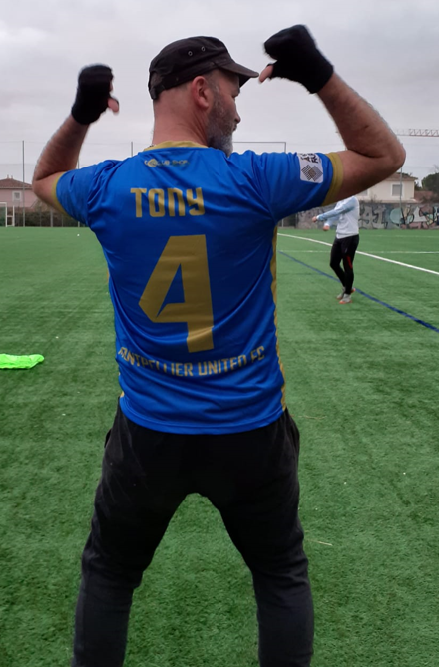
What seems to be happening…
Societies increasingly expect young people to show personal agency through transitions, but they need access to guidance resources to do so effectively.
The Career Readiness indicators highlight resources that make a difference in transitions.
Effective guidance creates a virtuous circle of students exploring, experiencing and thinking about their futures – clarifying, confirming, enabling their transitions.

Slide 32
The relation between guidance activities, workplace experiences and more beneficial career thinking
Activity/ experience | Career certainty | Career ambition | Career alignment | Instrumental motivation
Career advisor | √ | √ |  | √
Career conversation | √ | √ | √ | √
Questionnaire | √ | √ | √ | √
Research internet | √ | √ | √ | √
Job fair | √
Workplace visit | √ |  | √
Volunteering | √ | √ | √
Part-time working | √
Statistically significant relationships (up to 5%).

Slide 33
Career conversations and career thinking

Slide 34
Conclusions 1
New evidence from multiple countries shows that guidance has a central role to play in enabling better employment outcomes for youth. Substantial new evidence underpins 11 confirmed indicators of teenage career readiness.
PISA 2018 tells us that often too few students are ‘career ready.’
Because teenage attitudes about work are so important to outcomes, and because they need time to develop, career guidance should begin well before the age of 15 (early, often and integrated) – and continue after the age of 15.
Students from a young age should extensively explore the world of work through their schools with rich episodes of employer engagement.

Slide 35
Conclusions 2
5. Students should gain first-hand experiences of the working word, including through volunteering and part-time work.
6. Effective systems will encourage, enable and require students to think critically and continually about their futures in work.
7. More research is required. Data on indicators is missing in some countries and questionnaires vary in level of detail, especially on the quality of more effective provision.

Slide 36
Fourteen questions for schools
1 Does your school help all students through secondary education to engage regularly with people in work through career fairs and especially career talks?
2 Does your school have a programme of workplace visits and/or job shadowing which enables all students to critically investigate workplaces for themselves?
3 Does your school teach students how to apply for a job, including interview practice?
4 Does your school help students to reflect on their existing and planned education and training choices in light of what they are learning about their career ambitions and the requirements of desired employment?
5 Does your school know if students are engaging in career conversations about their career plans?
6 Does your school have a policy to encourage and enable a culture of career conversations?
7 Does your school have confidence that all students will have first-hand experience of work before leaving secondary education?

Slide 37
Fourteen questions for schools
8 Does your school give all students the opportunity to experience work of interest for themselves on two or more occasions?
9 Does your school help students to prepare for, and reflect on, their first-hand experiences of work?
10 Does your school know what the occupational expectations of your students are?
11 If students are uncertain, does your school they have a process for investigating what is behind the uncertainty?
12 Does your school know how ambitious your students are and have policies in place to encourage and enable high ambitions?
13 Does your school know if your students’ occupational and educational plans are aligned?
14 Does your school know if students are able to see a clear relationship between their educational experiences and later employment outcomes?

Slide 38
Thank you! Next steps and keep in touch
A continuing Career Readiness project will focus on
Identifying international practice aligned with the empirical results
Exploring the use of digital technologies in guidance, and
Investigating how guidance can enhance access to ‘green jobs’ and address inequalities.
Please share your examples of job shadowing and career talks.
Visit the project website: https://www.oecd.org/education/career-readiness/
Sign up to our free monthly newsletter: career.readiness@oecd.org
Follow me on twitter: @AnthonyMannOECD
Contact me: Anthony.Mann@oecd.org

