Slide 1



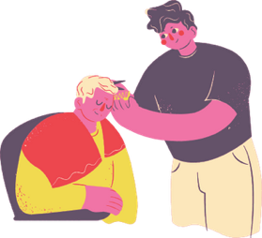








Careers in social care
Can be more varied than you may think

Slide 2
Types of providers
  Residential Homes
  Nursing Homes
  Supported living
  Day centres
  Home/Domiciliary

Slide 3
Myth busting
  Poor pay and conditions
  It's all about personal care
  A job for women
  Unsociable hours
  No future

Slide 4
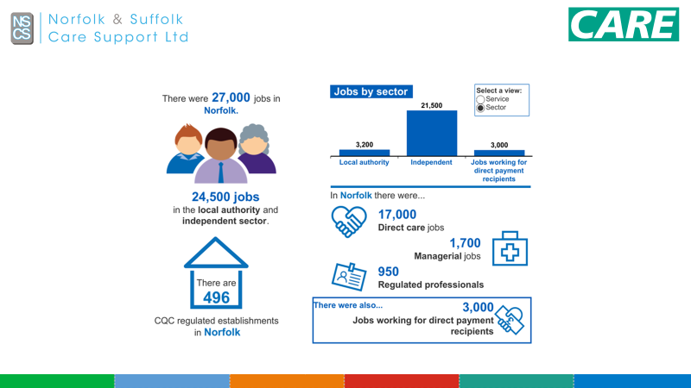

Slide 5
What learning pathways can social care offer?
  Apprenticeships one to one support
  Earn while you are learning - no student debt
  Career progression can be fast tracked
  Nurse training with the UEA

Slide 6
Apprenticeships have Maths & English elements
  Level 1 apprenticeships GCSE Grade D-G (1-3)
  Level 2 apprenticeship is equivalent to a GCSE grade 9
  Level 3 apprenticeships contain level 2 functional skills
  Level 4 apprenticeships contain level 2 functional skills
  Level 5 apprenticeships contain level 2 functional skills

Slide 7
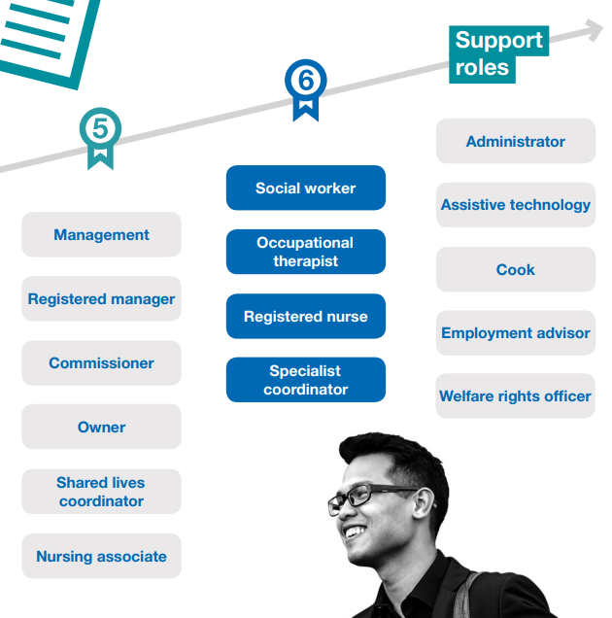
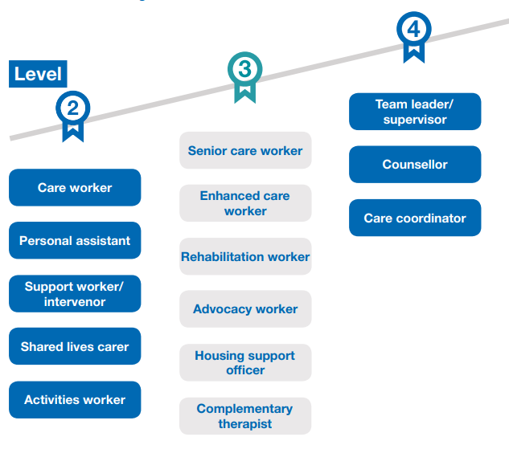

Slide 8
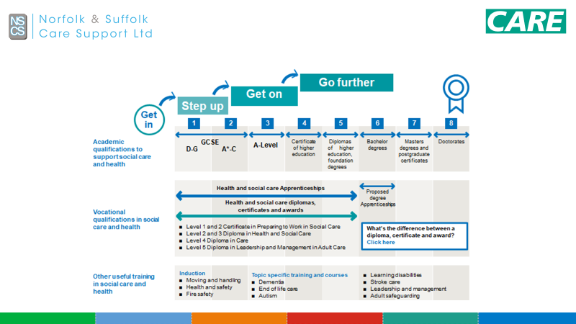

Slide 9
Values: The 6 C's
Care is our core business and that of our organisations and the care we deliver helps the individual person and improves the health of the whole community.
Compassion is how care is given through relationships based on empathy, respect and dignity - it can also be described as intelligent kindness.
Competence means all those in caring roles must have the ability to understand an individual’s health and social needs and the expertise, clinical and technical knowledge to deliver effective care and treatments.
Communication is central to successful caring relationships and to effective team working. Listening is as important as what we say and do and essential for ‘no decision about me without me’.
Courage enables us to do the right thing for the people we care for, to speak up when we have concerns and to have the personal strength and vision to innovate and to embrace new ways of working.
Commitment to our residents / clients is a cornerstone of what we do. We need to build on our commitment to improve the care and experience of our residents / clients.

Slide 10
Salaries
  Care assistant £21.500
  Senior care assistant £25.000
  Community outreach worker £28.000
  Head chef £30.000
  Care home deputy manager £ 35.000
  Care home manager £50.000

Slide 11
Earn as you learn
  Address the needs of each student by screening
  Link Students with social care providers
  Bank or casual work
  Flexible working around studies
  Practical experience for reflection
  Experience of work places and employers
  Supports further and higher education

Slide 12


