Slide 1
The Pathways to Work Team

Slide 2
The Team
Sam Hollis – PTW Coordinator
Eve Harrison – PTW Adviser
Kay Emmerson – PTW Adviser
Zina Mohn – PTW Adviser
Will Moffat – PTW Adviser

Slide 3
The Aim
The role of the team will be to promote awareness and uptake of apprenticeships, traineeships, T levels and other post 16/18 work based options and to support Norfolk’s young people aged 13-19 (to 25 years for SEND) to make successful progressions into apprenticeships and work.
The work of the Team will include delivery of the DfE Apprenticeships Support and Knowledge (ASK) programme for 2021/22.

Slide 4
ASK Contract
The team will be available to book apprenticeships information presentations, briefings and workshops to help ensure that young people are aware of the range of work based opportunities available to them.
Delivery will be available in a variety of ways including:
  Assemblies
  Class/group presentations
  Targeted group briefings and workshops
  Job search and applications workshops
Delivery can take place virtually or face to face depending on school/college policy and requirements and upon NCC and Government guidance. The team have been in contact with all Careers Leads, Heads of Sixth Form, partners and stakeholders over the last few months to introduce the service.
  Careers/opportunities fairs
  Parents/carer events
  Staff briefings

Slide 5
Targeted Work
Sam – Independent Schools, Short Stay School for Norfolk and voluntary groups in the Community
Eve – South Norfolk, East Norfolk, and Norwich – Elective Home-Education (Home-Ed)
Kay – Norwich, Broadland and North Norfolk – Looked After Children (LAC)
Zina – Breckland – Special Education Needs & Disability (SEND)
Will – West Norfolk and North Norfolk – Youth Offending Team (YOT)
YES Project working with young people who are NEET, in the criminal justice system, care experienced, unemployed or have experienced homelessness

Slide 6
Apprenticeship Levels
Intermediate – Level 2
Advanced – Level 3
Higher – Level 4-7
Degree – Level 6 & 7

Slide 7
Apprenticeships in Norfolk currently
(within 5 miles of Norwich)
Level 2 – 34 vacancies
Customer Service Apprentice Watts Marketing Limited £158.73 per week
Level 3 – 55 vacancies
Software Development Apprentice £25,000 p.a.
Level 4 – 2 vacancies
Apprentice Paraplanner Insight Financial Associates Ltd £19,000-£25,000 p.a.
Level 6 – 2 vacancies
Quantity Surveying Degree Apprenticeship Kier Limited £16,000 p.a

Slide 8
Apprenticeship Support and Knowledge
(ASK) Quarter 1 and 2
Norfolk County Council |  | Overall Achievement |  |  |  |  |  | Quarters 1 and 2 combined
KPI |  | Target (n) | Planned (n) | Actual (n) | Planned & Actual (n) | Planned & Actual (%) | Actual (%) | Target (%) | Target (n) | Planned (n) | Actual (n) | Planned & Actual (n) | Planned & Actual (%) | Actual (%)
1 | Establishments engaged | 37 | 6 | 23 | 29 | 78.38% | 62.16% | 59.5% | 22 | 1 | 23 | 24 | 109.09% | 104.55%
2 | Individual activities | 149 | 41 | 117 | 158 | 106.04% | 78.52% | 38.9% | 58 | 3 | 110 | 113 | 194.83% | 189.66%
3 | Development Schools | 1 | 0 | 1 | 1 | 100.00% | 100.00% | 100.0% | 1 | 0 | 1 | 1 | 100.00% | 100.00%
4 | Students | 10500 | 3636 | 4374 | 8010 | 76.29% | 41.66% | 41.7% | 4376 | 419 | 4168 | 4587 | 104.82% | 95.25%
5 | Teachers & careers leader training and development | 100 | 0 | 51 | 51 | 51.00% | 51.00% | 46.0% | 46 | 0 | 40 | 40 | 86.96% | 86.96%
6 | Parents & carers | 700 | 250 | 501 | 751 | 107.29% | 71.57% | 46.0% | 322 | 0 | 500 | 500 | 155.28% | 155.28%
7 | Registrations | 723 | 310 | 198 | 508 | 70.26% | 27.39% | 39.8% | 288 | 0 | 198 | 198 | 68.75% | 68.75%
8 | YAAN & apprentice/Trainee/T Level student engagement | 15 | 0 | 7 | 7 | 46.67% | 46.67% | 46.7% | 7 | 0 | 5 | 5 | 71.43% | 71.43%

Slide 9
2021/22 Apprenticeships starts
Headline data
Norfolk
Level | 2021-22 Q1 Starts | 2020-21 Q1 Starts | Difference | Percentage Change
Intermediate Apprenticeship | 457 | 281 | 176 | 62.63%
Advanced Apprenticeship | 823 | 531 | 292 | 54.99%
Higher Apprenticeship | 616 | 430 | 186 | 43.26%
Totals | 1896 | 1,242 | 654 | 52.66%
Norfolk
Age | 2021-22 Q1 Starts | 2020-21 Q1 Starts | Difference | Percentage Change
Under 19 | 567 | 309 | 258 | 83.50%
19-24 | 510 | 340 | 170 | 50.00%
25+ | 819 | 593 | 226 | 38.11%
Total | 1896 | 1,242 | 654 | 52.66%

Slide 10
2021/22 Apprenticeships starts
Headline data
Norfolk
Sector | 2021-22 Q1 Starts | 2020-21 Q1 Starts | Difference | Percentage Change
Agriculture, Horticulture and Animal Care | 73 | 36 | 37 | 102.78%
Arts, Media and Publishing | 8 | 2 | 6 | 300.00%
Business, Administration and Law | 503 | 398 | 105 | 26.38%
Construction, Planning and the Built Environment | 159 | 76 | 83 | 109.21%
Education and Training | 76 | 62 | 14 | 22.58%
Engineering and Manufacturing Technologies | 296 | 106 | 190 | 179.25%
Health, Public Services and Care | 464 | 378 | 86 | 22.75%
Information and Communication Technology | 83 | 43 | 40 | 93.02%
Leisure, Travel and Tourism | 34 | 19 | 15 | 78.95%
Retail and Commercial Enterprise | 196 | 120 | 76 | 63.33%
Science and Mathematics | 2 | 2 | - | 0.00%
Social Sciences | 2 | 0 | 2
Totals | 1896 | 1242 | 654 | 52.66%

Slide 11
2021/22 Apprenticeships starts
Headline data
Norfolk
Starts by District | 2021-22 Q1 Starts | 2020-21 Q1 Starts | Difference | Percentage Change
Breckland | 298 | 211 | 87 | 41.23%
Broadland | 295 | 204 | 91 | 44.61%
Great Yarmouth | 186 | 123 | 63 | 51.22%
Kings Lynn and West Norfolk | 348 | 231 | 117 | 50.65%
North Norfolk | 151 | 114 | 37 | 32.46%
Norwich | 276 | 171 | 105 | 61.40%
South Norfolk | 342 | 188 | 154 | 81.91%
Totals | 1,896 | 1,242 | 654 | 52.66%
Data source: https://explore-education-statistics.service.gov.uk/data-tables/apprenticeships-and-traineeships
* Percentage change is derived from comparing current Q1 2019/20 cumulative data with previous Q1 2018/19 cumulative data
* The following data sets illustrate the local and national picture for apprenticeship starts; all data is RAG rated to indicate a positive (green) or negative (red) movement on the previous year/period.
Note: Where data is split by Q1 or Q2 within same year, improvements from Q1 to Q2 have also been indicated (amber) despite the data still being a negative position.

Slide 12
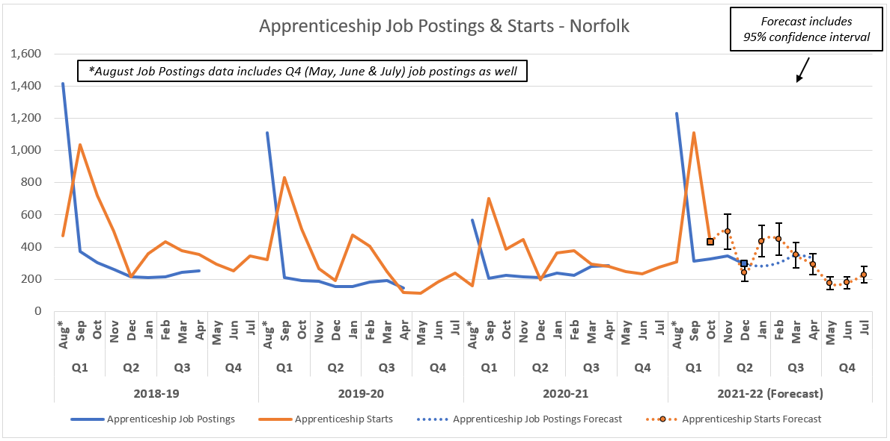
Apprenticeships Forecast Norfolk

Slide 13
How we can work together…
Supporting with individual cases
Sharing information
Staff Continuous Professional Development
Parent support
Raising Awareness of work-based learning options
Linking with external agencies
Links with employers

Slide 14


To find out more
Contact us:
PTW@norfolk.gov.uk
sam.hollis@norfolk.gov.uk
eve.harrison@norfolk.gov.uk
kay.emmerson@norfolk.gov.uk
zina.mohn@norfolk.gov.uk
will.moffat@norfolk.gov.uk
@AppsNorfolk
@ApprenticeshipsNorfolk

