Slide 1
November Photos
2018

Slide 2
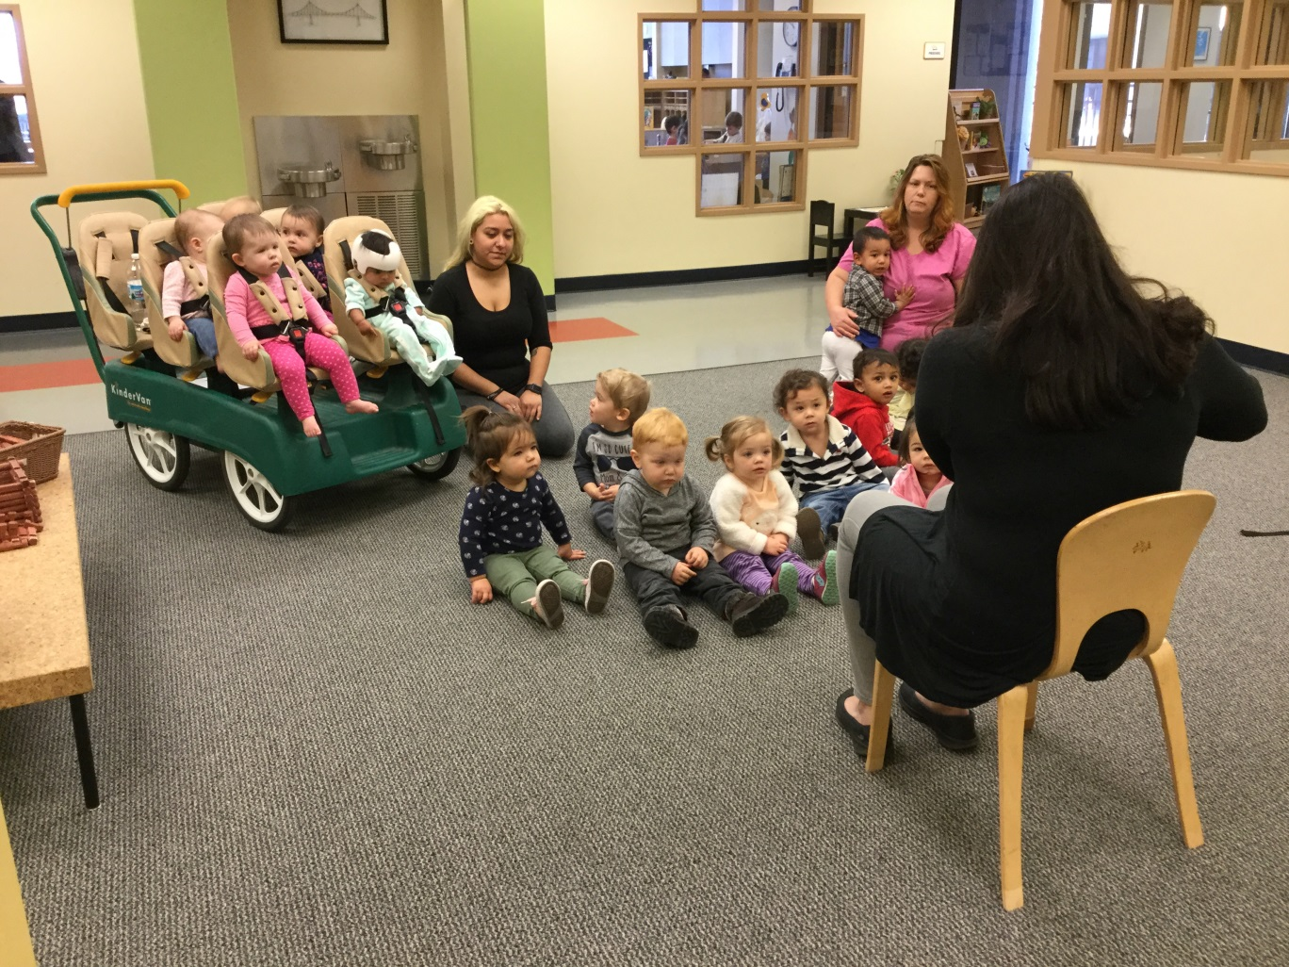
Growing Readers Program
Language and literacy development plays a central role in children’s success.
Parent Partnership plays an important role in this program.

Slide 3
