Slide 1


LEGAL ASPECTS
IN THE OPERATION OF
SOLARGROUP

Slide 2

PLACE OF SOLARGROUP INCORPORATION
2017 — REGISTRATION IN THE REPUBLIC OF VANUATU.
2024 — CHANGE OF JURISDICTION TO THE UNION OF THE COMOROS.
THE REASON IS MORE ATTRACTIVE CONDITIONS FOR DOING BUSINESS WITHIN THE FRAMEWORK OF THE COMPANY'S FURTHER DEVELOPMENT STRATEGY
Notes:
SOLARGROUP is committed not only to improving the internal processes of the company, but also the external factors, the conditions in which we do business.
SOLARGROUP is an international company that unites people all over the world, regardless of geographical borders and political relations.
It has always been important for us to create favourable conditions for conducting our activities, as well as transparency and accessibility of our business.
We are constantly looking for solutions to keep us on track and one of those solutions was the relocation of our company from the Republic of Vanuatu, where the company had been registered since 2017, to the jurisdiction of the Union of the Comoros as of 2024.
Our team has done a tremendous amount of work to make this happen.

Slide 3



WHY THE COMOROS?
LEGAL CONDITIONS AND A WIDE RANGE OF OPPORTUNITIES FOR CROWDINVESTING
MAXIMUM ECONOMIC EFFICIENCY
THE OPPORTUNITY TO LEGALLY ACCEPT INVESTMENTS WORLDWIDE
Notes:
The Republic of Vanuatu had been consistently enforcing stricter requirements and imposing new restrictions on business. Jurisdiction in the Union of the Comoros enables us to do business independently, freely and cost-effectively.

Slide 4

SOLARGROUP LICENCE
THE COMPANY HAS AN INTERNATIONAL BROKERAGE AND CLEARING LICENCE NO. L15658 / SG DATED MARCH 1, 2024, ISSUED BY THE FINANCIAL AUTHORITY OF THE AUTONOMOUS ISLAND OF ANJOUAN PURSUANT TO GOVERNMENTAL DECREE NO. 005 2005
Notes:
To date, our company has completed all the necessary registration activities in the new jurisdiction and obtained a special international brokerage and clearing licence. Among other things, this licence allows us to issue securities and carry out transactions with them. Currently, the company is not engaged in such activities, but it is possible in the long-term perspective. In the shortest possible time we plan to finalise all legal formalities related to our relocation. Nothing will change for our investors and partners. SOLARGROUP will remain the same company, only with a changed place of registration.

Slide 5

REGULATING RELATIONS BETWEEN THE PROJECT INVESTORS AND SOLARGROUP
EACH INVESTOR SIGNS (ACCEPTS) THE INVESTMENT AGREEMENT IN THE BACK OFFICE
INFORMATION ABOUT THE POTENTIAL RISKS OF INVESTING IS PUBLICLY AVAILABLE ON THE COMPANY'S OFFICIAL WEBSITE
Notes:
Each investor signs the investment agreement in the back office on the SOLARGROUP company's website. You can read it in advance, and also view the agreement in your profile, the "Documents" section, at any time after signing. Investments always carry a certain risk. We also warn about it on our website. We try to be as open and honest as possible with our investors and partners.

Slide 6
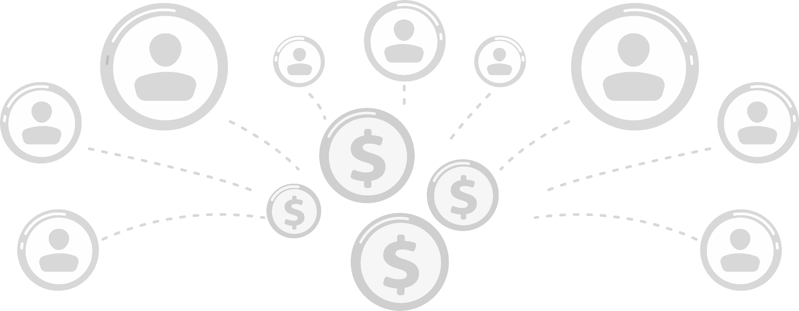
LEGAL STATUS OF A SOLARGROUP PARTNER
A PARTNER IS AN AGENT OF THE COMPANY WHO, VOLUNTARILY AND IN ACCORDANCE WITH INTERNATIONAL LAW, ACTS AS A CONSULTANT ON THE PROJECT
A PARTNER RECEIVES A LEGITIMATE MONETARY REMUNERATION FOR DISSEMINATING INFORMATION ABOUT THE COMPANY
Notes:
A partner is a company's agent who, voluntarily and pursuant to international law, acts as a consultant on the project. Partners act under the Directive 86/653/EEC relating to independent commercial agents, Article 10 and Article 11 of the Convention for the Protection of Human Rights and Fundamental Freedoms, Article 1 of the Hague Convention regulating the activities of representatives (agents) in the transfer of commercial proposals of the principal, the UNIDROIT Convention on the procedure for concluding contracts and the powers of intermediaries, the Benelux Convention (23.11.1973). A partner is entitled to receive legitimate remuneration for the dissemination of information about the company.

Slide 7

LEGAL STATUS OF A SOLARGROUP PARTNER
A PARTNER
IS NOT RESPONSIBLE FOR THE COMPANY'S ACTIVITIES
CANNOT RECEIVE MONEY FROM INVESTORS FOR HIS/HER OWN BENEFIT
IS NOT AN EMPLOYEE OF SOLARGROUP
IS NOT PAID A SALARY BY THE COMPANY
IS NOT AN AUTHORISED PERSON WITH RESPECT TO OPENING BRANCHES AND REPRESENTATIVE OFFICES OF THE COMPANY
THE PARTNER IS THEREBY EXEMPTED FROM LEGAL LIABILITY AND RECEIVES HIS/HER REMUNERATION IN ACCORDANCE WITH THE LAW
Notes:
A partner does not sell anything and does not trade in securities. He/she is neither an employee nor an official of the company. A partner cannot receive money directly from the project investors for his/her own benefit or for the benefit of SOLARGROUP. Investors' funds go directly to the company, and then the company pays remuneration to the partner.
Each partner acts based on their own interests and the opportunity of receiving the partner remuneration. A partner engages in this activity at his/her own will and on a voluntary basis, and also pursuant to the Directive on Independent Commercial Agents, Article 10 and Article 11 of the Convention for the Protection of Human Rights and Fundamental Freedoms, Article 1 of the Hague Convention regulating the activities of agents when transferring commercial proposals of the principal and other international documents.
Thus, a partner is exempted from legal liability and receives his/her remuneration legitimately.

Slide 8


REGULATION OF RELATIONS BETWEEN PARTNERS AND SOLARGROUP
EACH PARTNER SIGNS A SERVICE PROVISION AGREEMENT FOR ATTRACTING SOLARGROUP WEBSITE USERS, BASED ON WHICH A PARTNER RECEIVES HIS/HER REMUNERATION
Notes:
The relations between a partner and the company are regulated by the agreement, available in the back office on the SOLARGROUP company's website.

Slide 9

REGULATION OF RELATIONS BETWEEN PARTNERS AND SOLARGROUP
THE AGREEMENT ENTITLES A PARTNER TO
INFORM ABOUT THE SOLARGROUP PROJECT
PARTICIPATE IN MARKETING EVENTS
GET REMUNERATION FROM THE COMPANY
Notes:
The agreement authorises a partner to inform people about the project in various ways, provide advice, and participate in marketing events.

Slide 10
SOLARGROUP AND SECURITIES MARKET
SOLARGROUP IS ENGAGED IN ATTRACTING INVESTMENTS INTO PROJECTS USING THE CROWDINVESTING MECHANISM
SOLARGROUP DOES NOT TRADE IN SECURITIES AND THEREFORE DOES NOT NEED THE STATUS OF AN AUTHORISED MARKET PARTICIPANT
SOLARGROUP PARTNERS ARE NOT AUTHORISED BROKERS AND THEIR ACTIVITIES DO NOT REQUIRE A LICENCE
Notes:
It is important to be aware that SOLARGROUP does not trade in securities within the framework of the project "Duyunov's motors", although it may do so in the future. Therefore, now the company and its partners do not need a special status of an authorised participant of the securities market. We are engaged in attracting investments in projects by means of crowdinvesting.

Slide 11
LEGAL GROUNDS
FOR SOLARGROUP ACTIVITIES
THE ACTIVITIES OF THE COMPANY AND OUR PARTNERS ARE ABSOLUTELY LEGAL
1
CHARTER OF ECONOMIC RIGHTS AND DUTIES OF STATES ADOPTED BY THE UNITED NATIONS GENERAL ASSEMBLY RESOLUTION 3281 (XXIX) DATED DECEMBER 12, 1974
2
INTERNATIONAL BROKERAGE AND CLEARING LICENCE
3
INTERNAL CONSTITUENT DOCUMENTS OF THE COMPANY
Notes:
The activities of our company are absolutely legitimate. They have all the necessary legal grounds — you can see them on your screen now.

Slide 12
QUESTIONS AND ANSWERS

