Slide 1

Careers in the Veterinary Sector
Ann Kent, BVetMed, Cert AVP (EP),MRCVS
Westover Vets Ltd

Slide 2
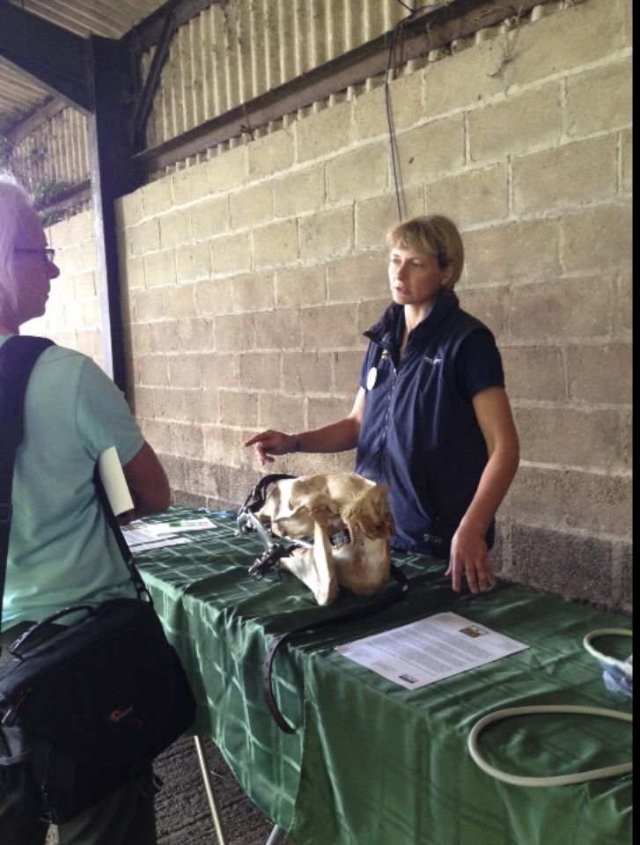
VETERINARY SURGEON
3-Alevels A*
5-6 years at university
10 universities to choose from in the UK
General practice
Referral practice
Acedaemia
Research
Drug sales

Slide 3
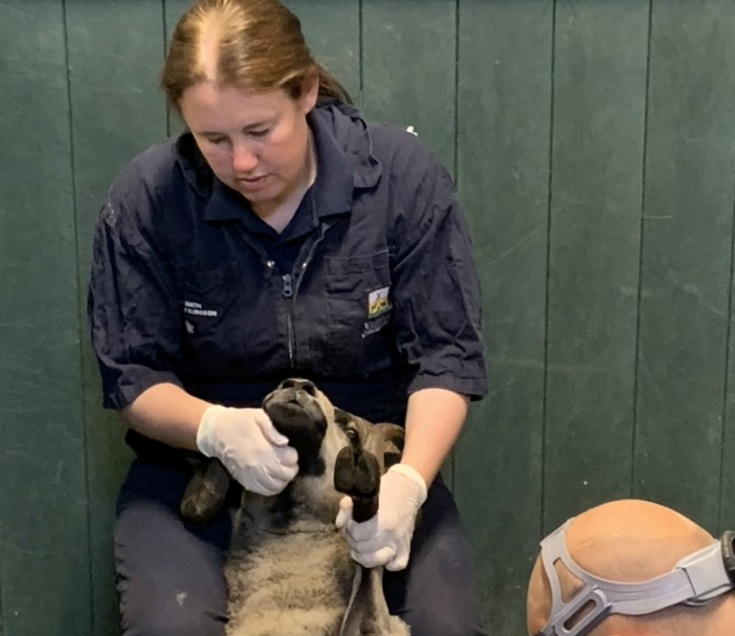
Veterinary Nurse
5 GCSEs including english and maths
Training-apprentiship based in training practices -part time college placement/university eg RVC
Specialise within the species
Specialise within-eg behaviour/nutrition/dentistry/ hydrotherapist
Level 3 diploma, typically 3 yrs or degree -3 years

Slide 4
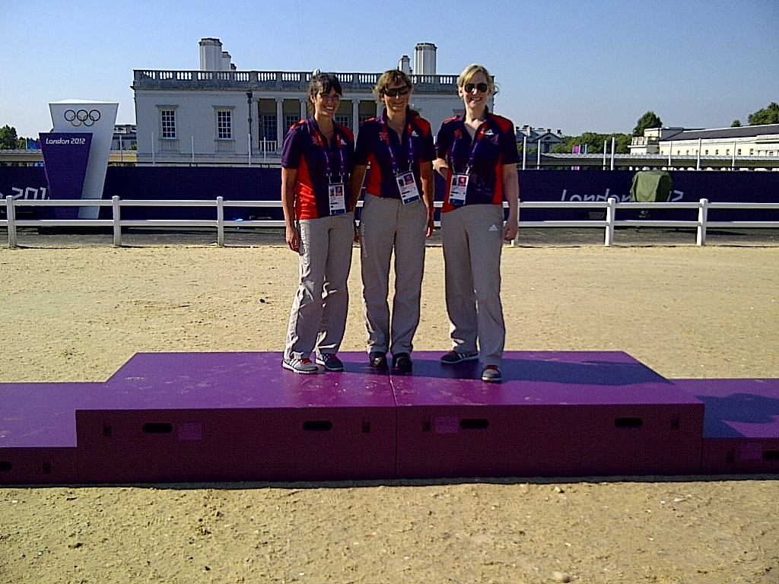
Veterinary Physiotherapist
Species specialization
Work at events-equine Olympics/dog agility
3-4 year course eg Harper Adams requires 3 Bs at A level, one in biology and
1 subject must be biology and another science based
1 year is placement based

Slide 5
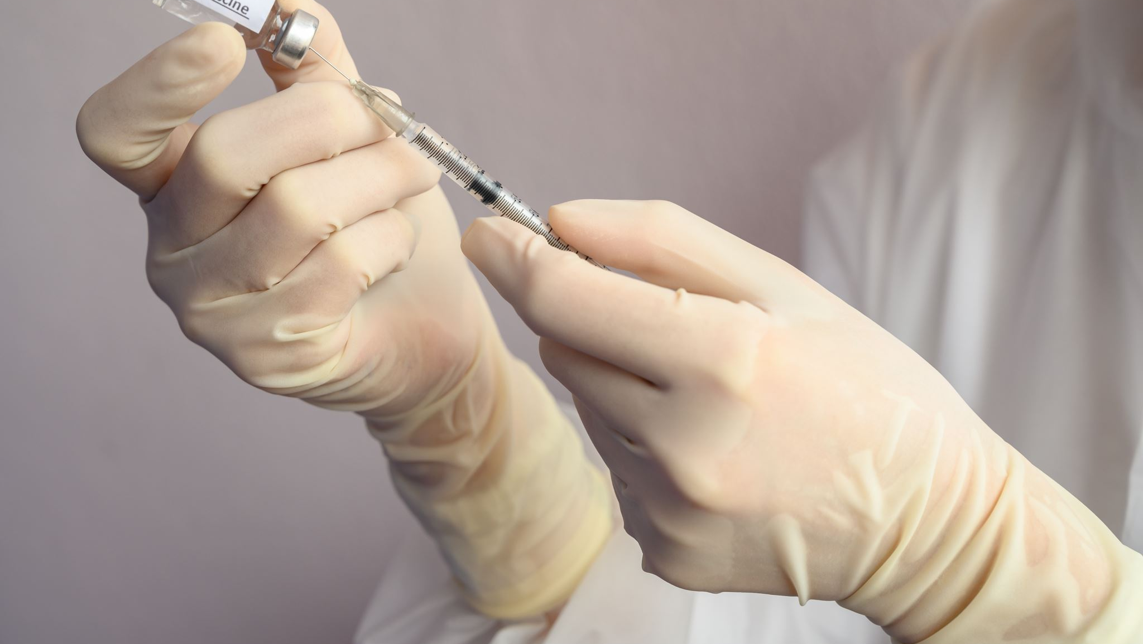
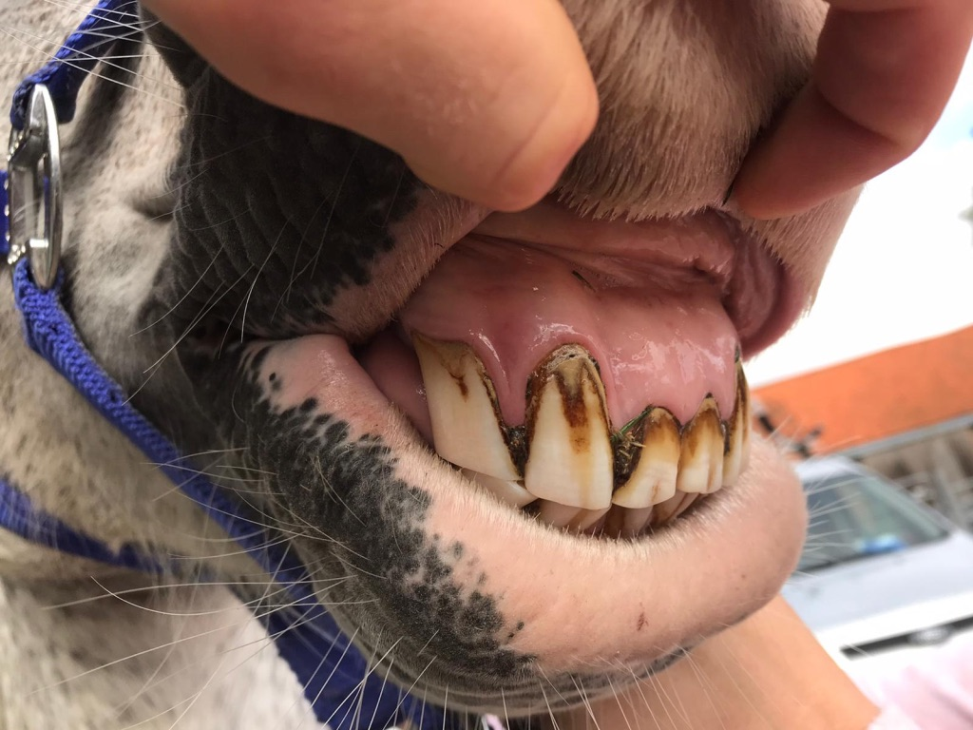
Equine paraprofessionals
Equine Dental technician
Chiropractor/Osteopath
Laboratory technician
Nutritionist
Behaviourisrts

Slide 6
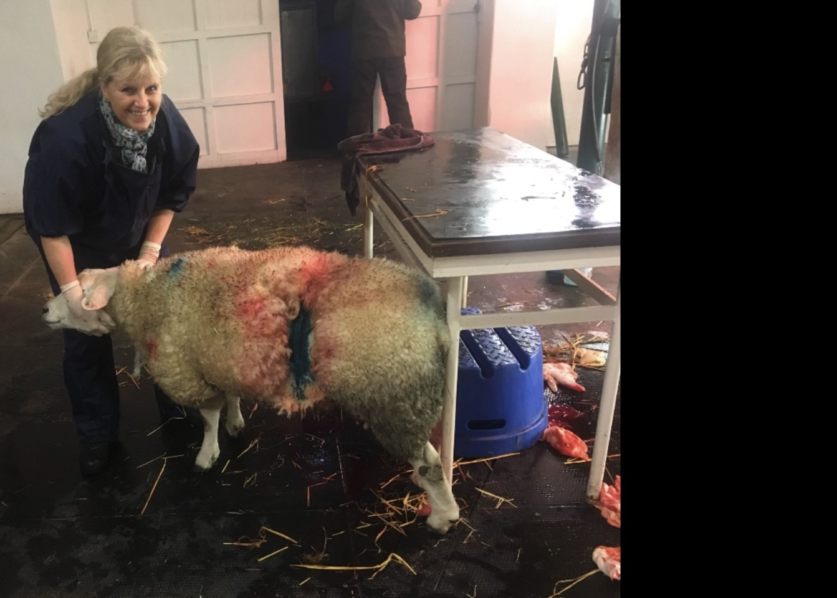
Veterinary Technician
Animal handling
Diagnostic imaging set up
Admin work
Restocking medicines
Animal care

Slide 7
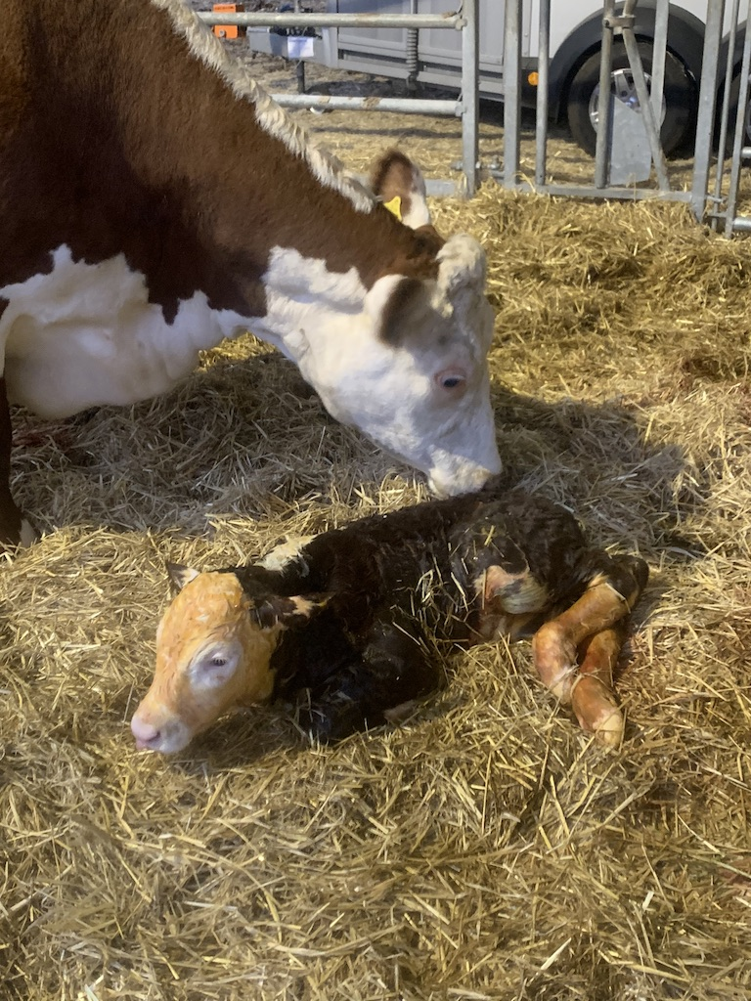
Farm Animal Paraprofessionals
Approved tuberculin tester AHP
Certification support officer-supporting vets in official controls for exports in relation to animal products-not germplasm or live animals .AHP
Veterinary technicians -disbudding, milk sampling, mobility scoring, vaccination plans, blood sampling, calf weight monitoring, foot trimming
Artificial Insemination technician-detect heat and inseminate cows

Slide 8
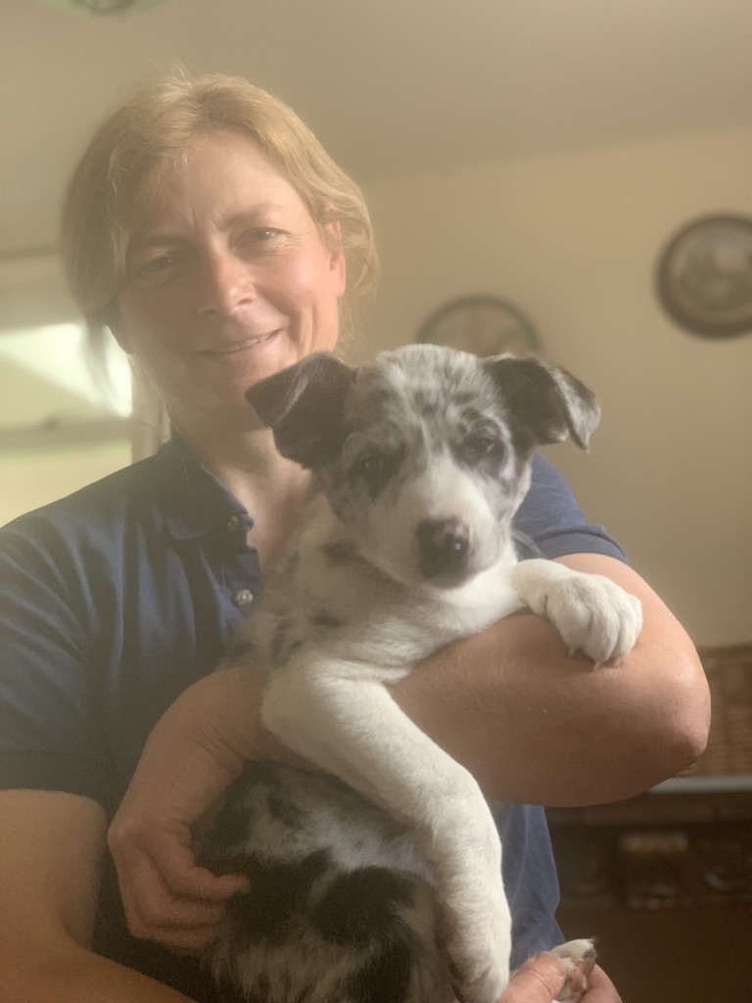
Small Animal Paraprofessionals
Physiotherapist
Behaviour consultant
Veterinary care assistant
Veterinary pharmacist
Suitably qualified person (SQP)
Veterinary receptionist

Slide 9
POSITIVES OF VETERINARY CAREERS
Caring sector-rewarding
Varied-cannot guarantee how animals behave
Can be outside/inside
Part of a small team
Meeting clients
Good career opportunities
Challenging

Slide 10
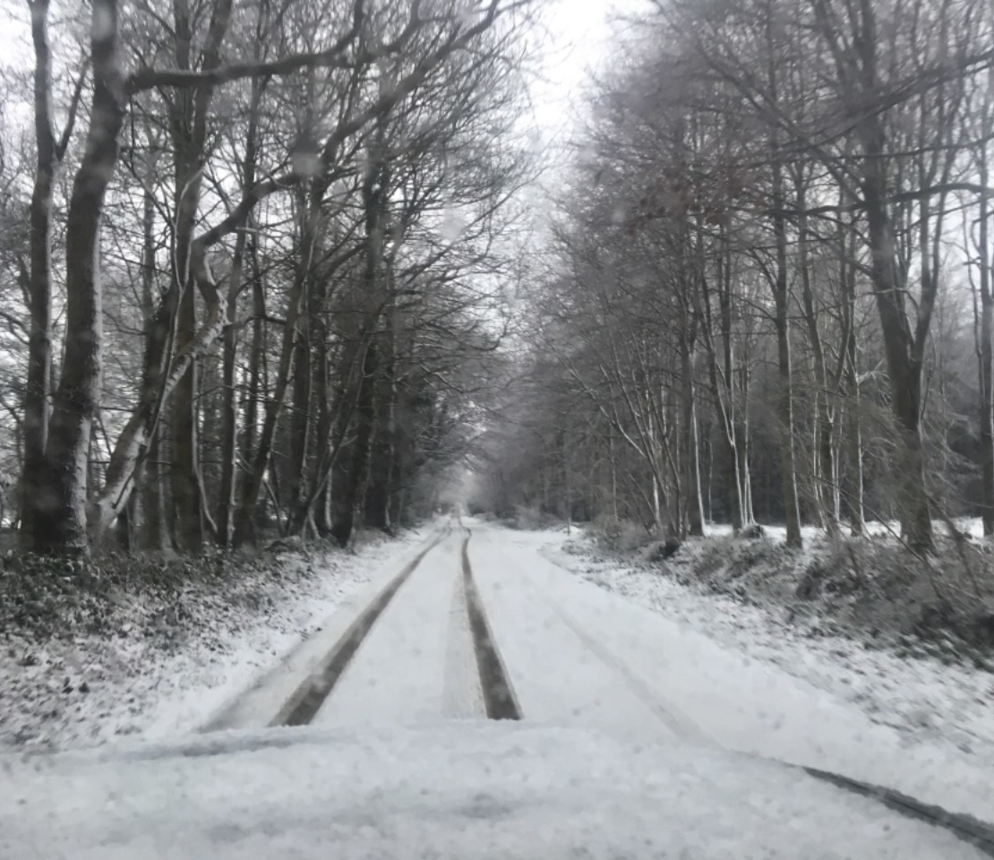
Negatives of veterinary careers
Having to work under pressure
Animals and people can be highly emotionally charged-dangerous and relatively high injury and suicide rates
Dealing with life and death
Long hours and OOH work
Outside in all weathers if working with horses and farm animals
Physically demanding-especially large animals
Can be alone for much of the day
Costs of studying

Slide 11
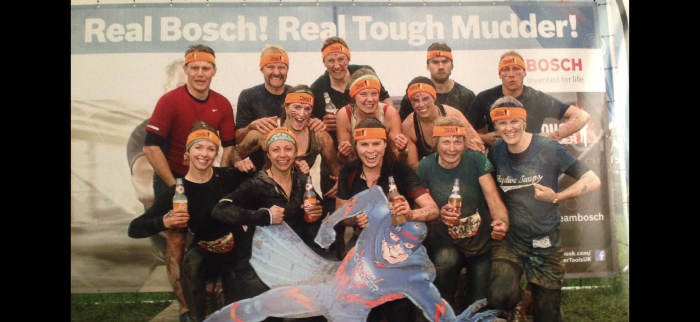
Industry Is changing due to poor retention
Better mentoring and training for graduates who are better prepared for the workplace.
Research the roles available and spend time with those already in the job.
I feel blessed that I have found a job that I love and that I work with a great group of people

