Slide 1

A career in Real Estate
Notes:
Introduce yourself: I am “NAME” and I work in Property at Savills.
Name, Age, what you did for GCSE and A Level.
What you did at university?
How did you get inspired to work in the industry?
Please Play the video clip to give them a bit of insight into what impact the industry has.....this one works better with sound.

Slide 2
What would a career in Property mean???
Great work/life balance
Get out and about
Not desk based all the time
Professional Qualification (like Law or Medicine)
Financial independence from an early age
Influence the environment you care about
Notes:
Property is a lively industry where the friends you make at university will become your clients and colleagues throughout your career, meaning there is good work life balance – we work hard, but we have fun too – give your own examples eg. Rugby 7s etc...
You work with real assets, like farms, restaurants, offices, houses and shops – which you get away from your desk to visit, inspect and deal with on a regular basis – so if sitting in an office for the next 40 years of your career doesn’t appeal, Property may be for you.
Like most Professional careers there is the opportunity to earn good money and control the kind of work you do.
If you’re interested in a professional career where you gain a degree and a professional accreditation like a lawyer, banker or doctor would, the Real Estate industry could be for you.
Real Estate (or Property) professionals buy, sell, value, design, rent, invest and manage any kind of property you can think of, so it’s a real opportunity to have an impact on your surroundings and on the Environment.....where would you build a wind farm? Which houses in your street would be worth more if they had solar panels etc? Where do you wish there was a new shop, bar, cinema?
If you enjoy Homes under the Hammer, Kirsty and Phil or Grand designs.....if you think any of the above apply to you, then you might like to consider a career in Property...

Slide 3

So what do you DO in Real Estate??
Notes:
Talk about the transactions which they might have expereinced on a house...
Thinking about building a house, development
The consent, Planning
Construction, you need a Building Surveyor to sign it off to say it’s safe
Want to sell one – you need an agent
Want to invest in one, you need an investment agent
To rent it out, speak to lettings / property management
Could they add solar panels? Speak to our energy team
Want an extension – we’re back to the planning team.....

Slide 4
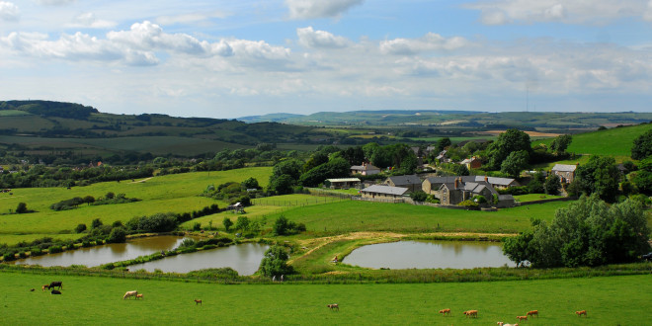

It’s not just houses.....
Notes:
Farms and Estates

Slide 5



Notes:
Shopping centres
Luxury flats (some of which can cost in excess of £100 million!!! (you get your own restaurant service with it!) One Hyde Park.
Leisure - even the occasional ski slope!!

Slide 6



Notes:
Hotels
Cinema
Offices

Slide 7


Notes:
Restaurants
And Shops

Slide 8

Next Steps
Research
  - Chartered Surveyors Training Trust
  - http://graduate.savills.co.uk/graduate-schemes/property-apprenticeships/
Social Media @careersinproperty , Estates Gazette, Property Week etc...
At GCSE and A Level (any topic, but Geography can be useful)
Apprenticeships VS full time University the graduate programme
Work experience
Notes:
Give them a little advice about what to do, researching firms, getting work experience, read property press etc...
CSTT is the governing body for surveying apprenticeships. Their website is a hub for all apprentices to apply to all vacancies plus has lots of information on it.
Follow Savills on twitter @careersinproperty
Tell them that whether they want to start work straight away or go to uni, there is an option
Talk a little bit about the common graduate route (information on apprenticeship on next slide)
Find out more by getting work experience, go into your local estate agency or apply using company websites

Slide 9

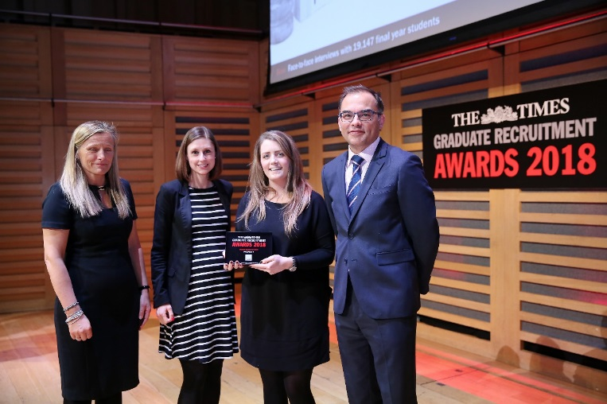

Savills graduate programme
Real responsibility and real opportunity from day one
Training for professional qualification
Working with Directors
Client contact
Investment in you
Support
Our rotation
Permanent contract
Global opportunities
Notes:
FC
What makes us different?
At Savills you are given responsibility from day 1
Directors will expect your input and like it when graduates take responsibility especially with making Client contact.
We really invest in you – we offer a very structured training programme to nurture you through your APC.
4 month rotations across the 2 year programme – great exposure to the business.
You are offered a permanent contract – great job security.
AND we are the proud owners of the “Graduate Employer of Choice” Award for the last TEN years!

Slide 10
Savills Apprenticeship – Level 6
5 year programme, working 4 days a week with 1 day study per week
Gain a Surveying undergraduate degree, fully funded by Savills
Work towards your professional accreditation for Surveying (APC)
Learn on the job with a team of experts
Positions across the UK
Starting Salary £17,000 plus benefits (training, degree, membership, pension, healthcare)
Good work life balance – its a fun job!!
To read about the Apprenticeship experience at Savills visit our website
Apply May / June
Savills website

Slide 11
Surveying the Future
Notes:
Ask for any questions then play the video
Please Play the video clip “Surveying the Future” to give them a bit of insight into what impact the industry has.....

