Slide 1



Notes:
Introduce Apprenticeships Norfolk – our externally facing brand; and three operational teams within it – Apps Norfolk (individuals aged 19+ and businesses across Norfolk); Insight Apprentice (intensive wraparound support for SMEs in growth sectors in Norfolk) and PTW (explained later!)

Slide 2

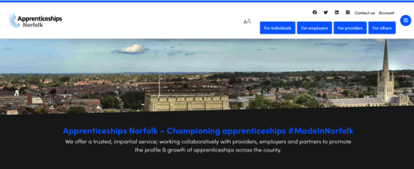
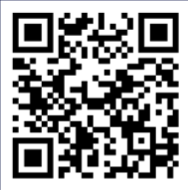
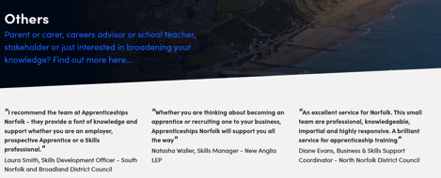

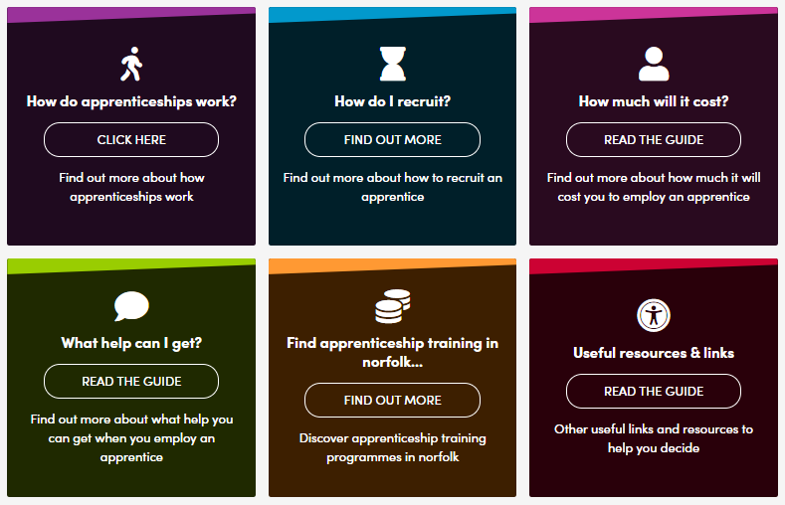
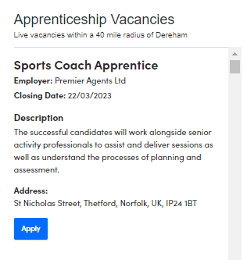

Support for you…
Notes:
Introduce Apprenticeships Norfolk website and dedicated area for people supporting others with apprenticeships – tons of info, including useful information written in plain English and links to gov.uk and also on homepage, a live link to ‘Find an Apprenticeship’ – if they haven’t already, advisors can email us apprenticeships@norfolk.gov.uk and we will mail the updated apprenticeship vacancies across the whole of Norfolk, each week!

Slide 3
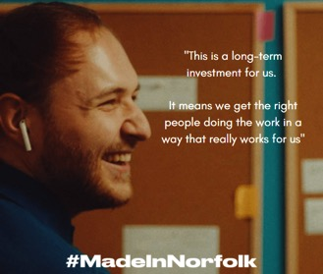
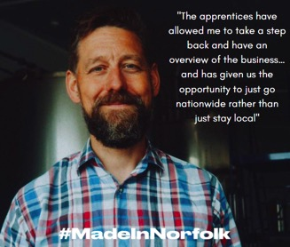
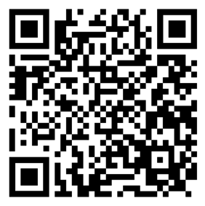
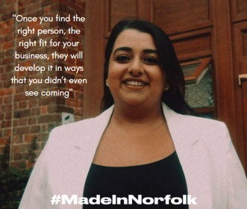
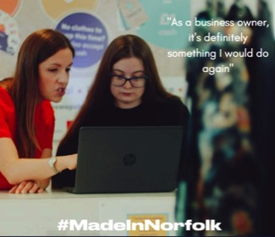
#MadeInNorfolk
Notes:
Our #MadeInNorfolk campaign - produced short films as part of a multi touch digital campaign that complimented a TV advert... Using real SMEs in Norfolk to influence and talk directly to other SMEs in Norfolk about the benefits of apprenticeships to their business…
These SME’s represented the apprenticeship scope with traditional sectors like care and retail and also emerging technology (machine learning creating fully automated sign language via a human avatar) –which all represented Norfolk.
QR code links to the films..

Slide 4


Notes:
Introduction to the presentation.
Thank you for your time this morning/afternoon my name is “insert name” and I am here today to give you some information on who the pathways to work team.
The pathways to work team are part of Norfolk County Councils Children's services and we aim to support all young people to fulfil personal, social,
academic and career potential to successfully transition to economic independence in adulthood. An we are committed to promote and develop a viable and high-quality pathway to apprenticeships for 16-18-year olds wishing to enter the labour market as a key option for 16-18 participation.

Slide 5
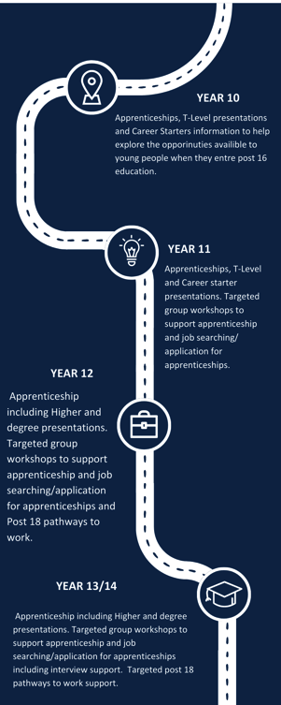
The Aim
We take pride in supporting education establishments in Norfolk to promote awareness and uptake of apprenticeships, T levels and other post 16/18 work based options and to support Norfolk’s young people aged 13-19 (to 25 years for SEND) to make successful progressions into apprenticeships and work.
The work of the Team will include delivery of the DfE Apprenticeships Support and Knowledge (ASK) programme for 2022/23.
Notes:
The Aim/ year groups
Sophie
Top industries in Norfolk
Employment

Slide 6
7088
School Engagement
40
233
Students supported from Sept 22-Feb 23
9000
Schools and colleges engaged from Sept 22- March 23
30% increase from Aug-March 21-22
Activities delivered from Sept 22- March 23
Compared to 178 activities delivered in Aug-March 21-22
Students we aim to engage with
Notes:
Schools of engagement

Slide 7








Awareness sessions
Registration Workshops
CV workshops
“personable, approachable and took time to realise the dynamics of the groups. Interacted well with learners from various learning levels and managed to successfully engage all who attended”
Overview of the opportunities
the different sectors and levels available.
Introduction to the online government services ‘Find an apprenticeship’
To prepare students for apprenticeship and job application process.
Mock Interview support/sessions
Support for parents and carers
Careers Fairs
Providing students with the opportunity to experience what a real interview might be like.
To inform students and their parents or carers about apprenticeships and the benefits
Designed to showcase apprenticeships, traineeships and T Levels as career opportunities to parent and carers
Notes:
The Delivery
Info outline ask/ptw offer
The ASK programme is funded by the Department for Education and offers free support to educational establishments in England to increase awareness of apprenticeships, traineeships and T Levels.
Activities and workshops
The activities and workshops delivered through ASK are inspiring sessions that are delivered by local experts (ASK delivery partners), on behalf of the Department for Education.
All activities and workshops are designed to inform and inspire your students, staff and parents about apprenticeships, traineeships and T Levels. You can read more about them later in this brochure.
Most activities have been designed flexibly so that they can be delivered as a face to face or virtual session, depending on what works best for your school/college.
Some activities can only be delivered in-person and we encourage schools and colleges to book activities as an in-person session wherever possible to increase engagement and overall impact.

Slide 8

Apprenticeship Headline Data 2022- March 2023
A total of 1055 (5.8%) of year 12 and 13’s are recorded as apprentices as of March 2023
1055

Slide 9
Apprenticeships Vs Whole Cohort by Academic Age
Academic Age | Whole Cohort | Apprenticeships | % of Cohort on Apprenticeships
16 | 8986 | 390 | 4.3%
17 | 9049 | 662 | 7.1%
18 | 8917 | 637 | 7.3%

Slide 10




Whole Cohort age 16-17 by Gender VS Apprentices age 16-17 by Gender
Whole Cohort age 16-17 by gender
Gender | Whole Cohort | Apprenticeships | % of Cohort on Apprenticeships
Female | 8550 | 406 | 4.7%
Male | 9290 | 641 | 6.9%
Unknown/Other | 198 | 8 | 4.0%
Female 47.4% | Male 51.5% | Other 1.1%
Apprentices age 16-17 by gender
Female 38.48% | Male 60.76% | Other 0.76%
Notes:
Data for gender old Data 2 slide

Slide 11

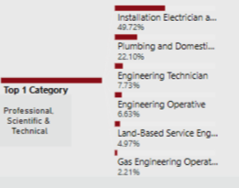
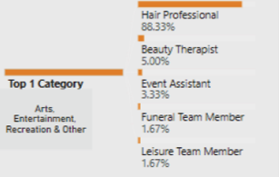
Top 5 Sector Categories Male | %
Professional, Scientific & Technical | 27.30%
Construction | 23.55%
Motor Trades | 10.14%
Agriculture, forestry & fishing | 6.08%
Production | 3.58%
Top 5 Sector Categories Female | %
Arts, entertainment, Recreation & Other | 18.96%
Health | 16.74%
Education | 16.50%
Accommodation & Food Services | 12.31%
Business Administration & support services | 11.82%
Notes:
Break down of district

Slide 12

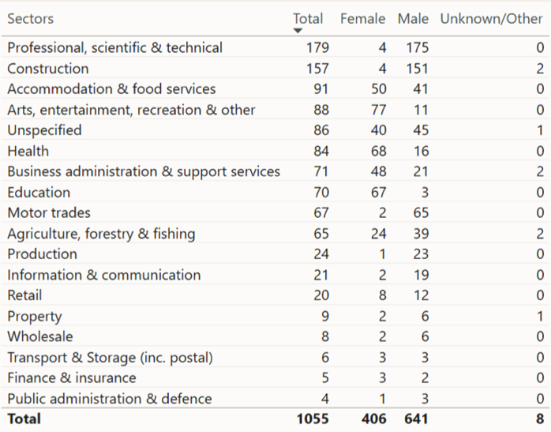
Apprenticeships by Sector 16-17 Cohort
Notes:
Break down of district

Slide 14

How we can collaborate to support young people onto apprenticeships
Notes:
WE
Quick opening segment to get CA to think about how their practice supports young people to get into apprenticeships
So I just have a few statements that I want to get you thinking about with how you support your young people when applying/searching and looking for apprenticeships.
Are all students in Years 10, 11, 12 and 13 given access to information about apprenticeships, regardless of their academic ability and planned / intended destination?
Are students who complete apprenticeship applications supported by staff members e.g. proof reading, providing feedback, support to meet deadlines?
Are students encouraged to consider the transferability of content from their UCAS personal statements to the apprenticeship application process?

Slide 15

Contact us at: ptw@norfolk.gov.uk
Notes:
Plenary/ Question

